Slide 1
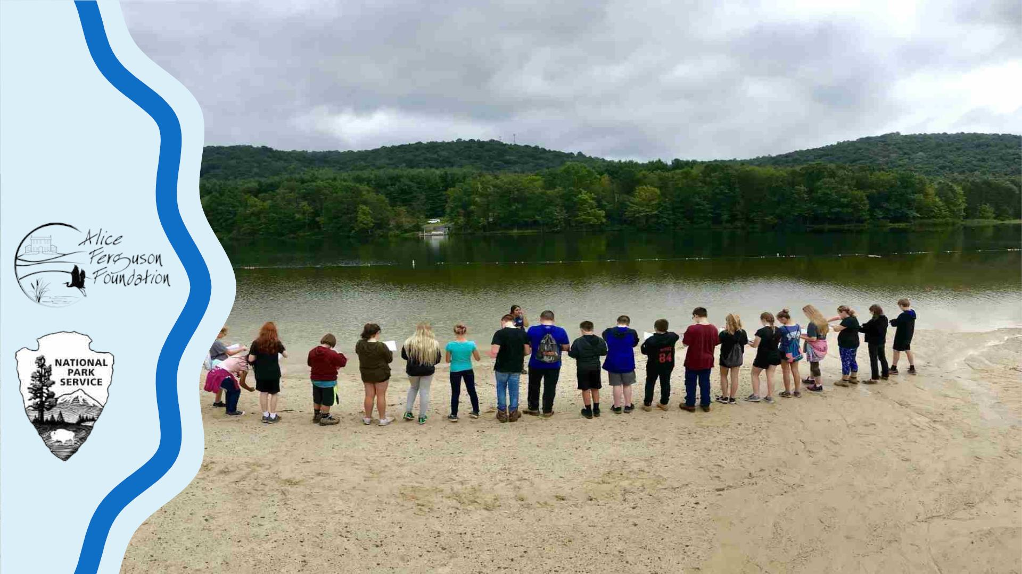
Alice Ferguson Foundation’s
Bridging the Watershed
An outreach program of the Alice Ferguson Foundation in partnership with the
National Park Service and area school systems

Slide 2
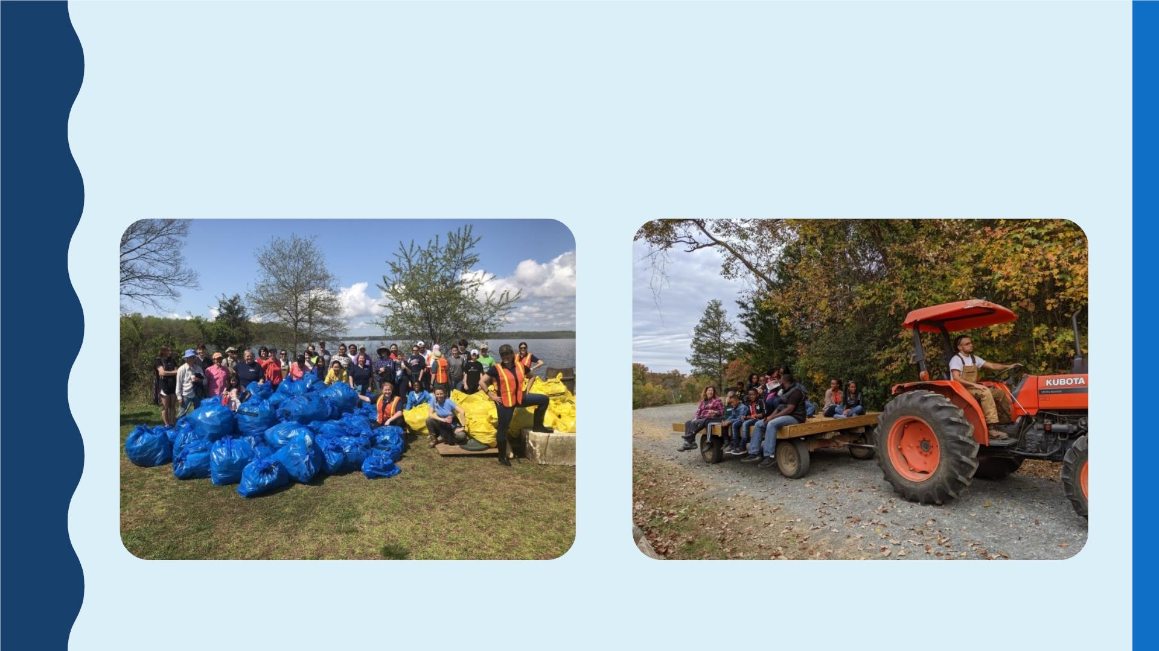
ALICE FERGUSON FOUNDATION

Slide 3
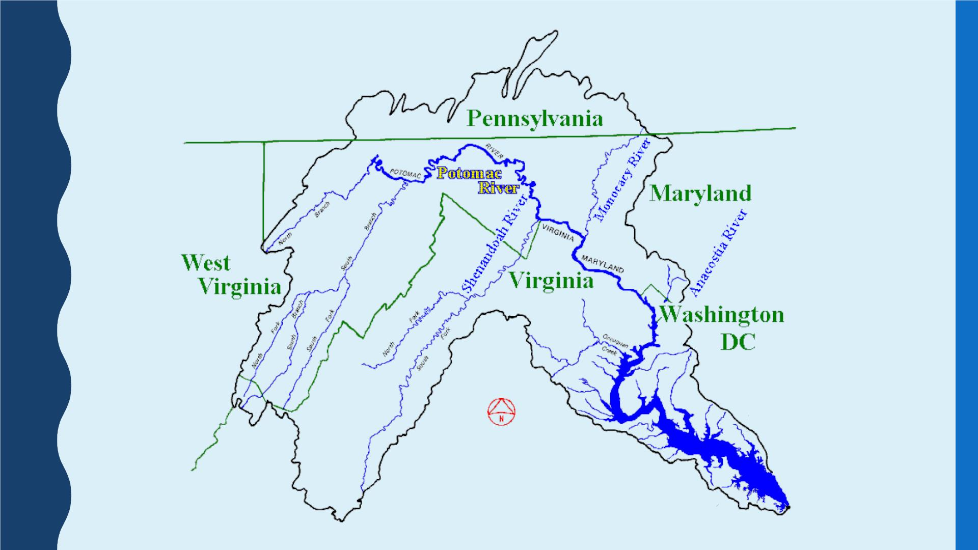

Slide 4
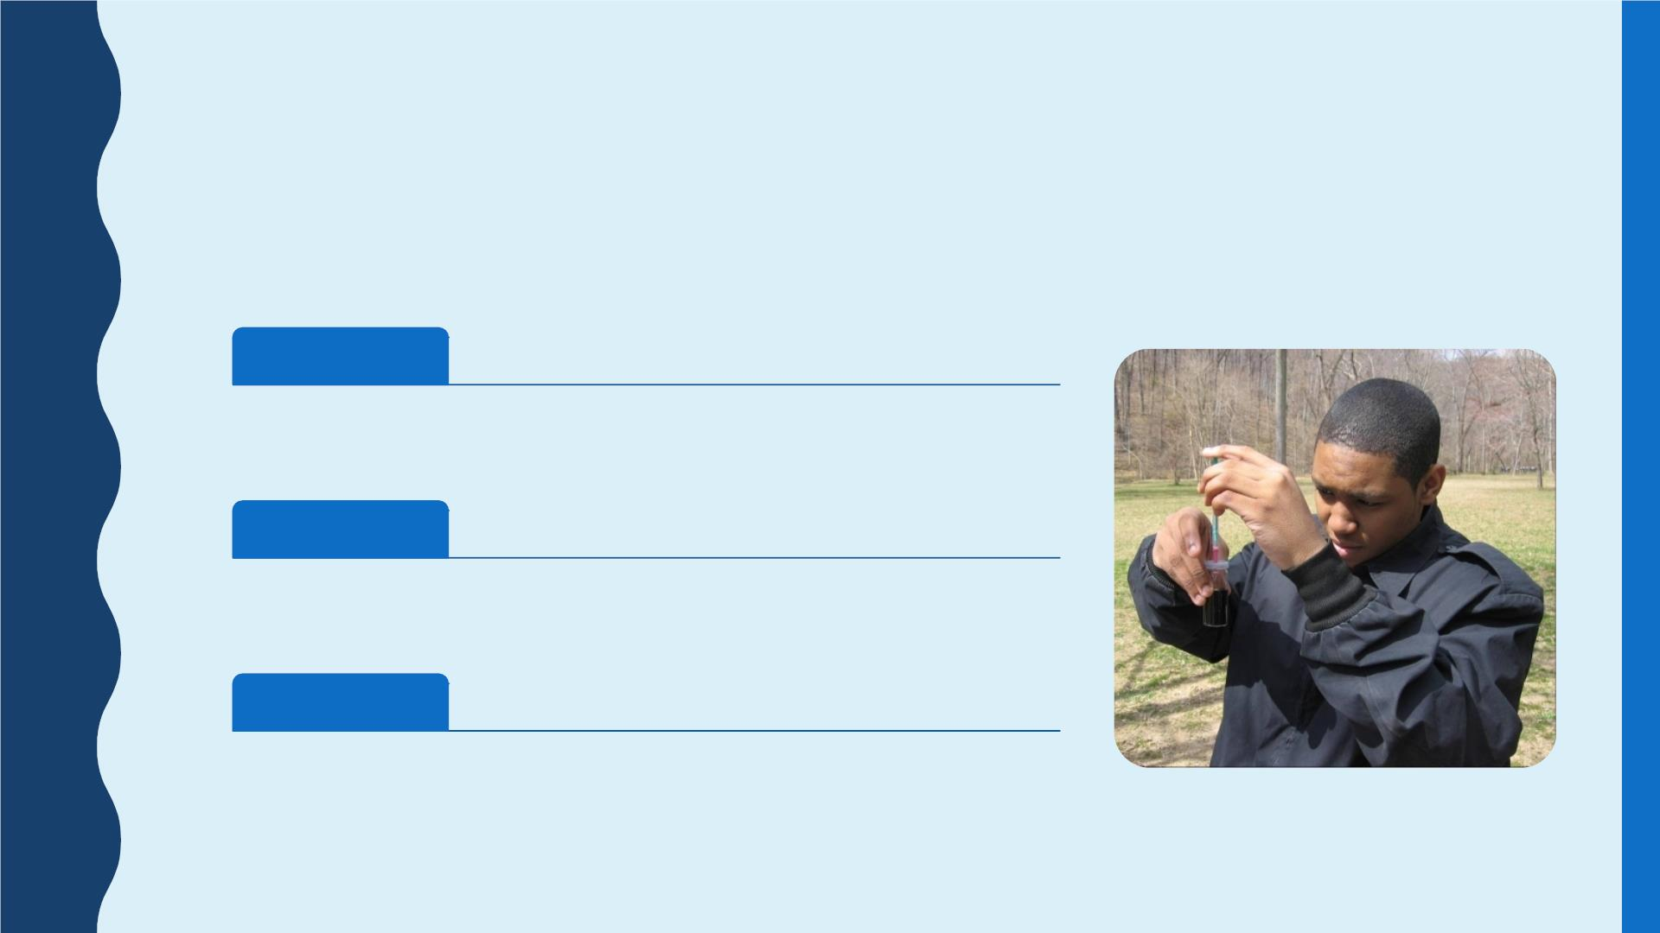
BRIDGING THE WATERSHED (BTW)
Hands-on curriculum-based outdoor studies in National Parks and Public Lands.
Desired Outcomes:
Academic
• Intro to STEM careers
Civic
• Community Awareness
• Watershed Stewards
Indivdual
• Personal connection to natural world
• Wide ranging health benefits

Slide 5
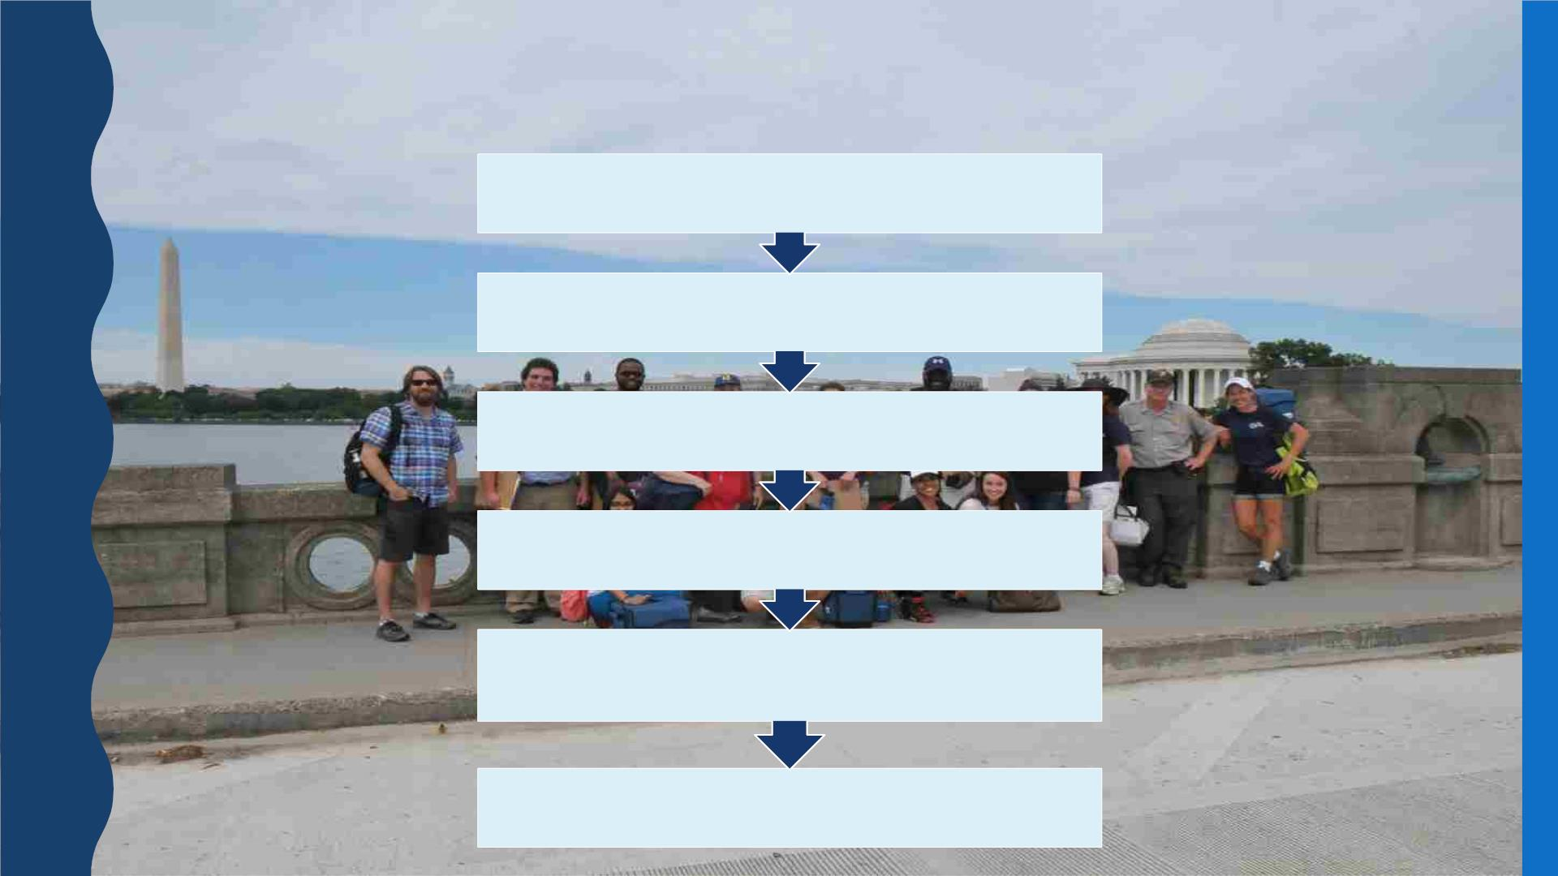
BTW PROCESS
Teacher Training
Schedule a Field Study
Pre-Activities
Field Study
Data Analysis and Post-Activities
Student Action

Slide 6
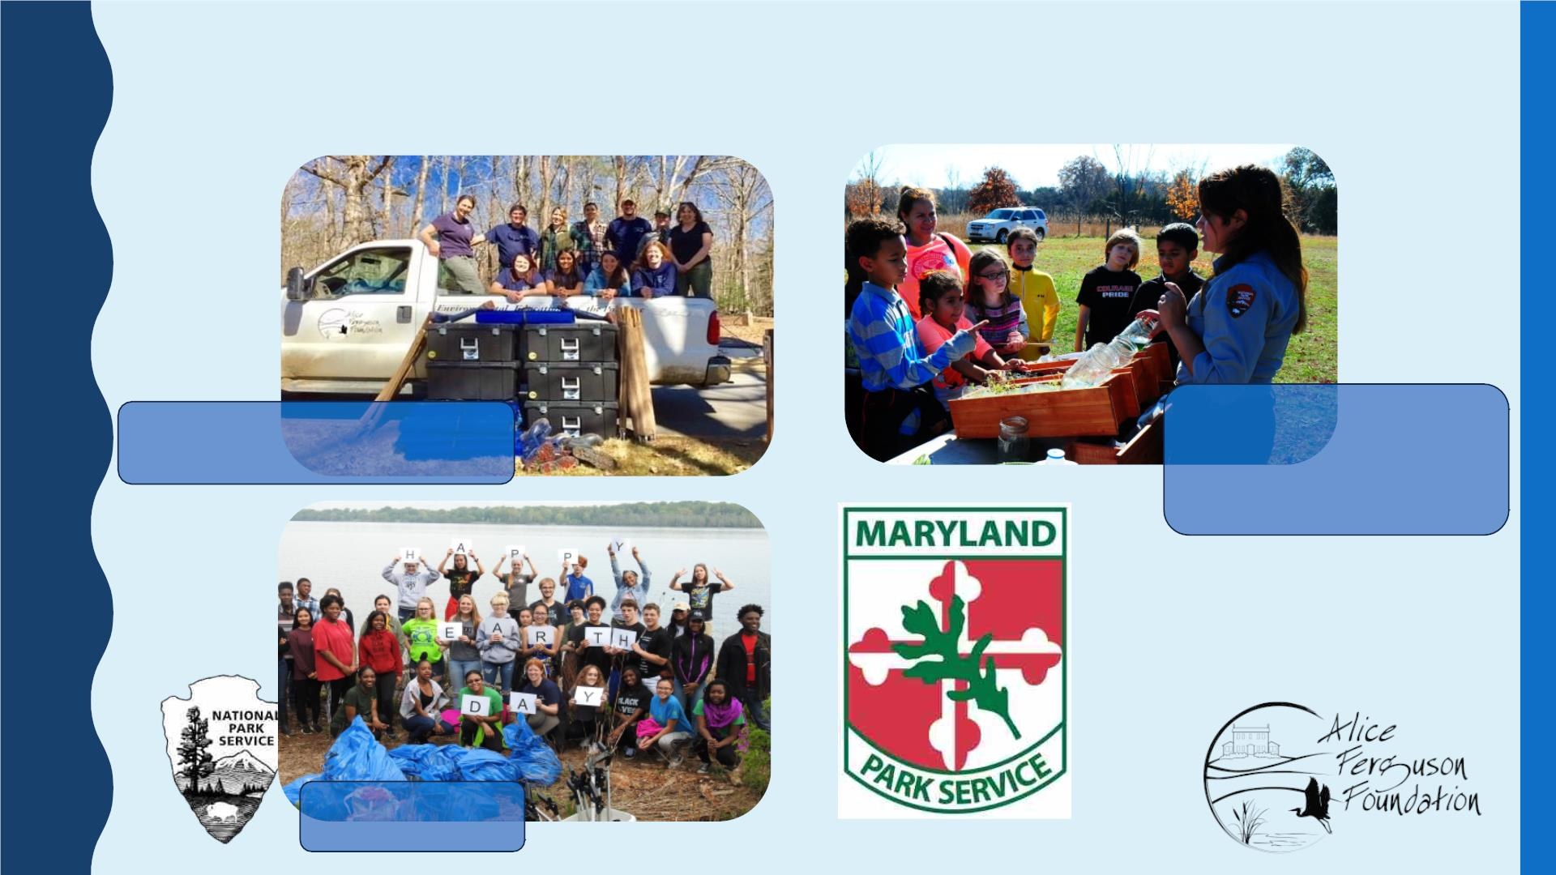
BTW IS A PARTNERSHIP
Alice Ferguson Foundation
National Park Service
National Capital Region
NE Region
Area Schools

Slide 7
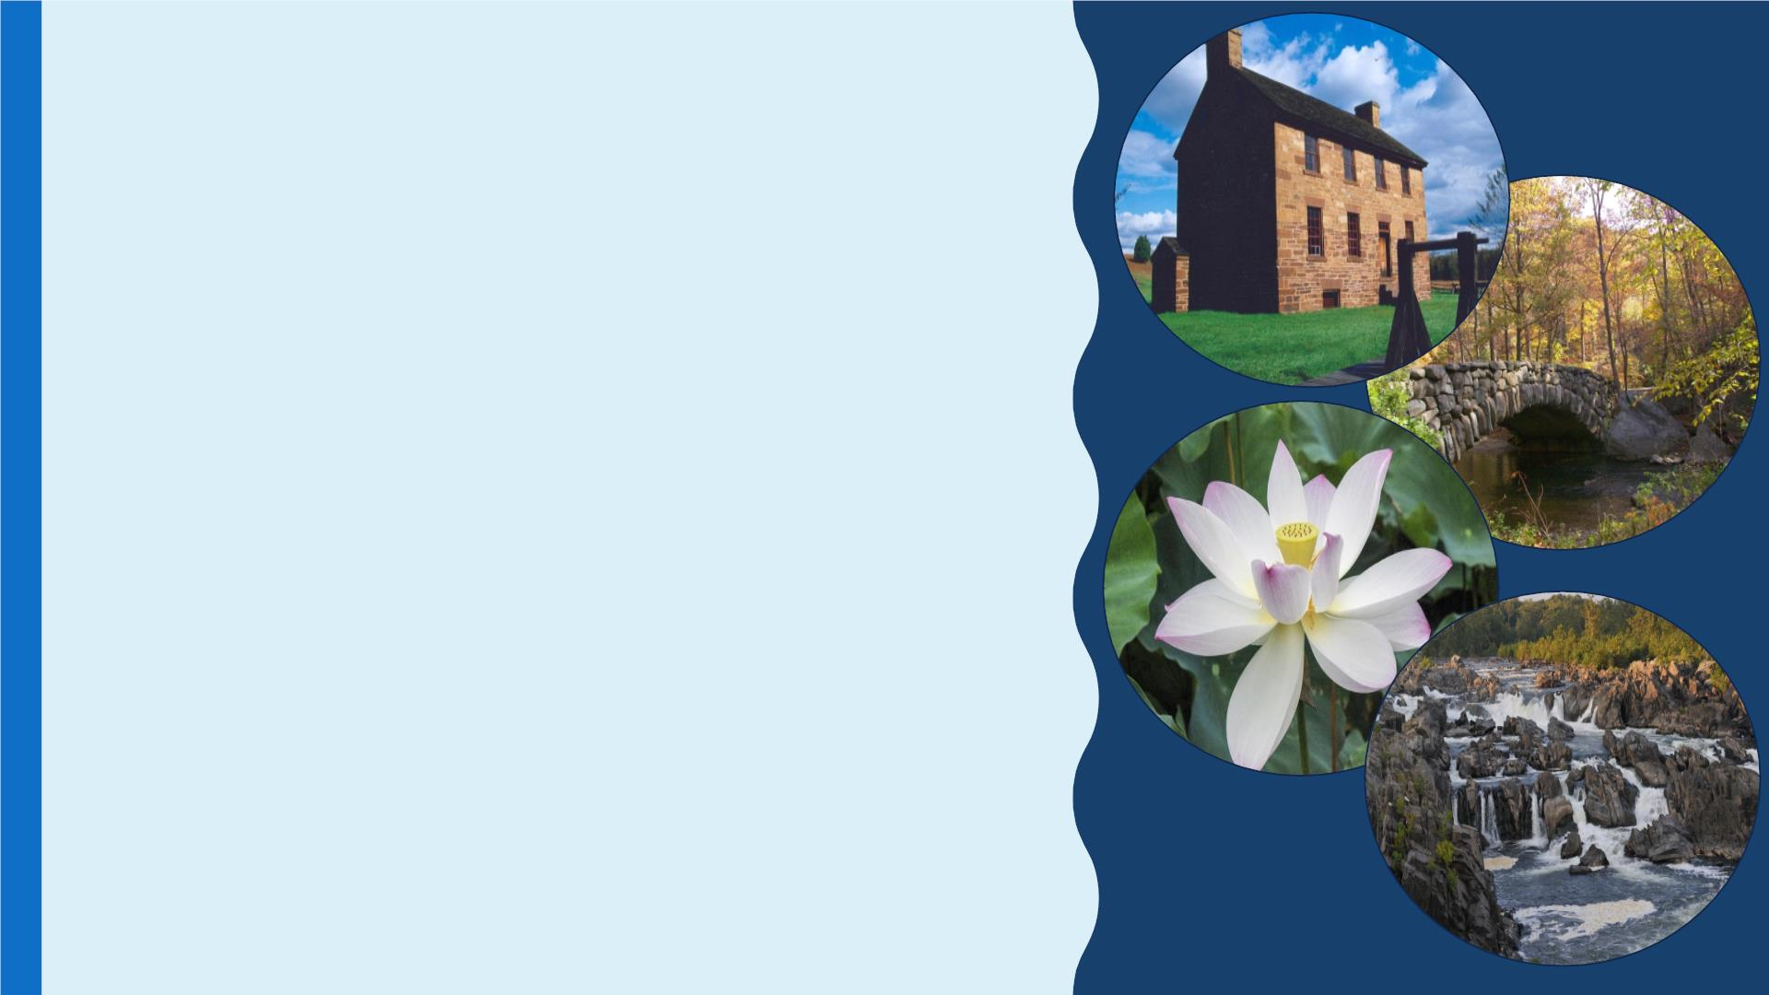
PARTICIPATING PARKS
This is a list of the parks we have previously worked with. We hope to expand
back out to these parks post-pandemic. Currently participating parks are
marked with a red asterisk (*).
• Chesapeake & Ohio Canal National Historical Park
• Great Falls Park
• National Mall & Memorial Parks – FDR Memorial*
• Rock Creek Park*
• Prince William Forest Park
• Fredericksburg and Spotsylvania NMP
• National Capital Parks East:*
– Anacostia
– Fort Washington
– Greenbelt
– Kenilworth
– Oxon Cove
– Piscataway** Our home base
• Maryland Park Service:
– Merkle Wildlife Sanctuary
– Smallwood

Slide 8
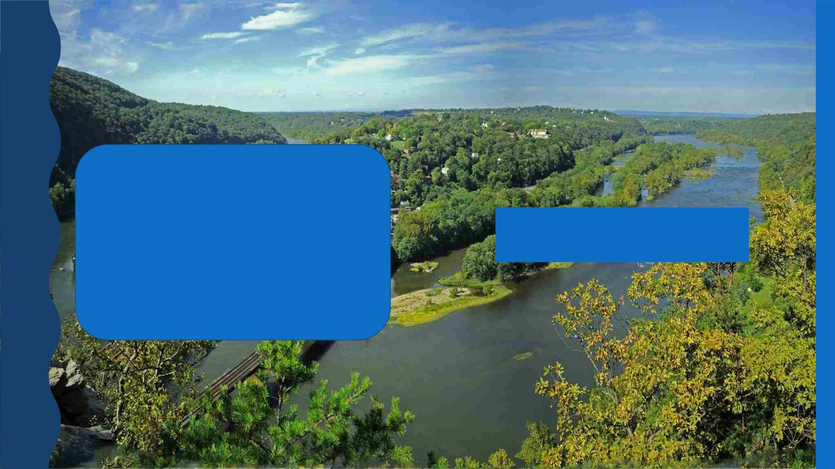
PARTICIPATING PARKS
WESTERN MARYLAND
• Antietam NBP
• Catoctin Mountain Park
• Chesapeake & Ohio Canal National
Historical Park
We may expand back out to
these parks in the future!
• Harper’s Ferry National Historical Park
• Monocacy National Battlefield
• Rocky Gap State Park

Slide 9

CORE MODULES
● Water Canaries
○ macroinvertebrate investigation
● Watershed Watchdogs
○ water quality and water chemistry
● Exotic Invaders
○ biodiversity and invasive species
● Sustainability
○ sustainable design and renewable energy
● Talkin’ Trash
○ litter in our watershed

Slide 10
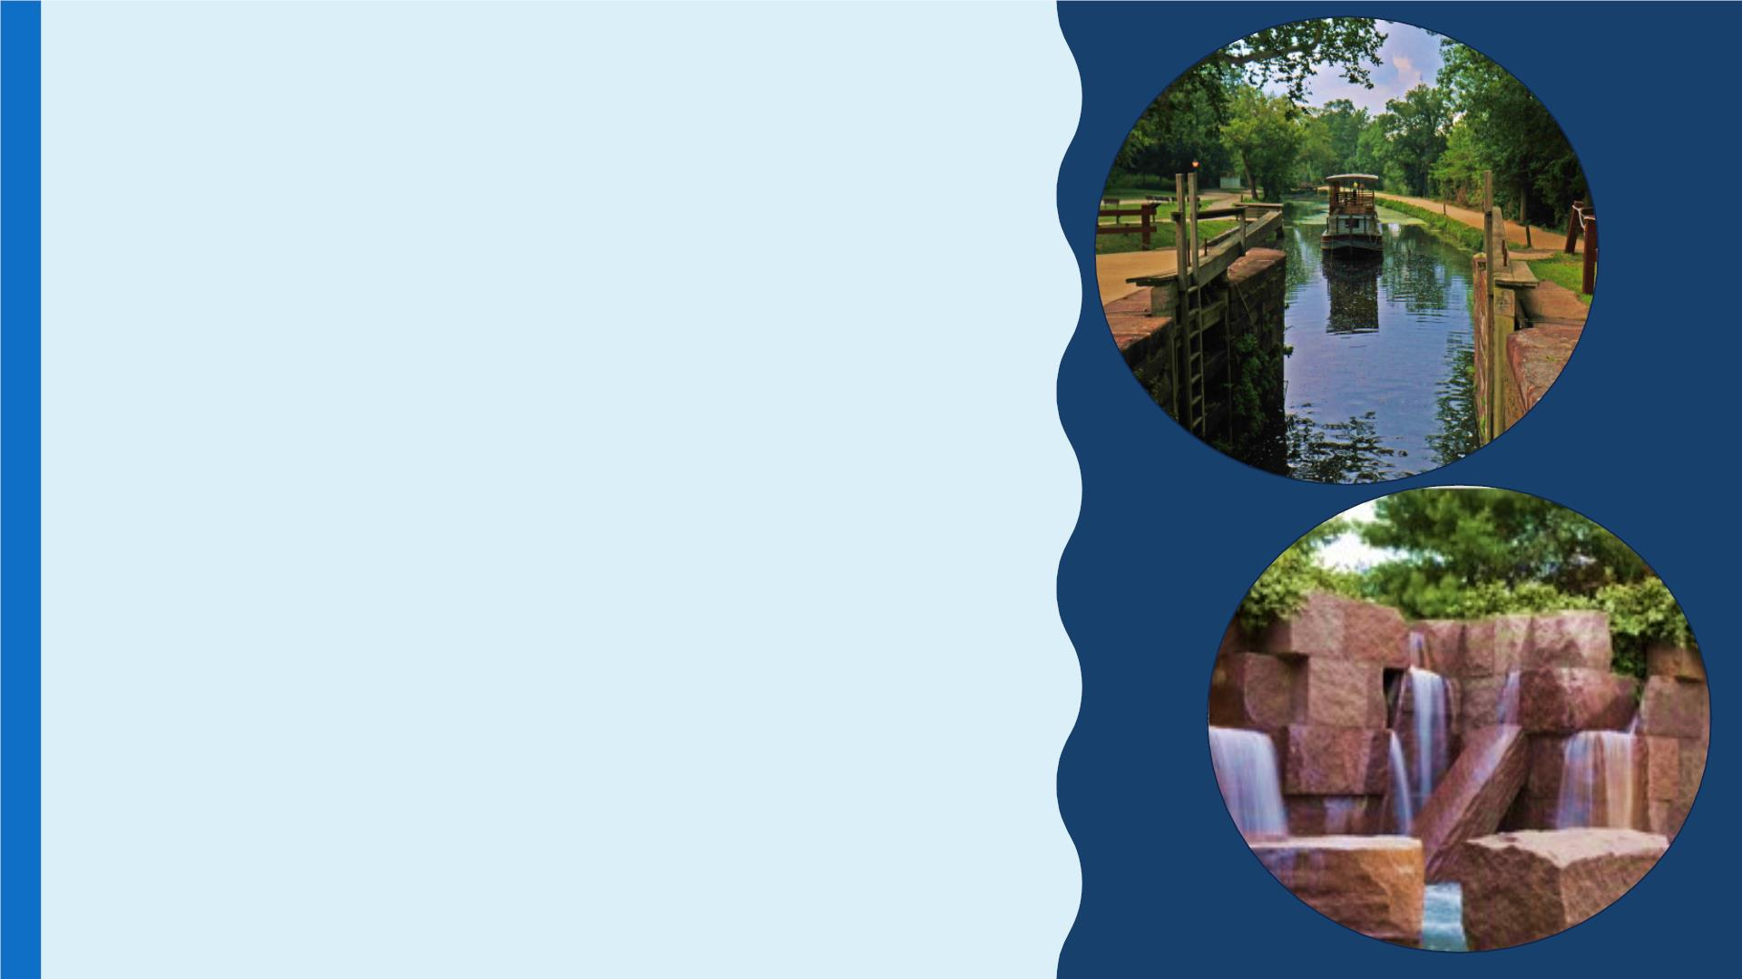
BTW Park Specific
Modules
These modules are
• Herring Highway
– Rock Creek Park
• Potomac Gorge
– Great Falls Park
currently not available,
but we may offer them
again in the future.
– Chesapeake & Ohio Canal NHP
• Water Power
– Harper’s Ferry
• Urban Pools
– National Mall and Memorial Parks
• Mine Over Matter
– Prince William Forest Park
• Battle to Save Water Quality
– Monocacy National Battlefield

Slide 11
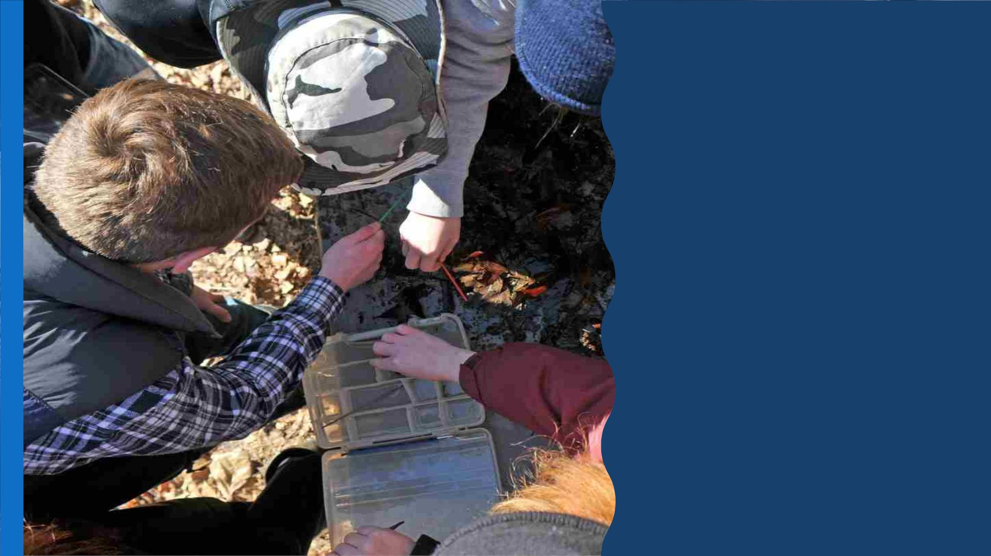
WATER
CANARIES
Assessing Water Quality
using Benthic
Macroinvertebrates

Slide 12
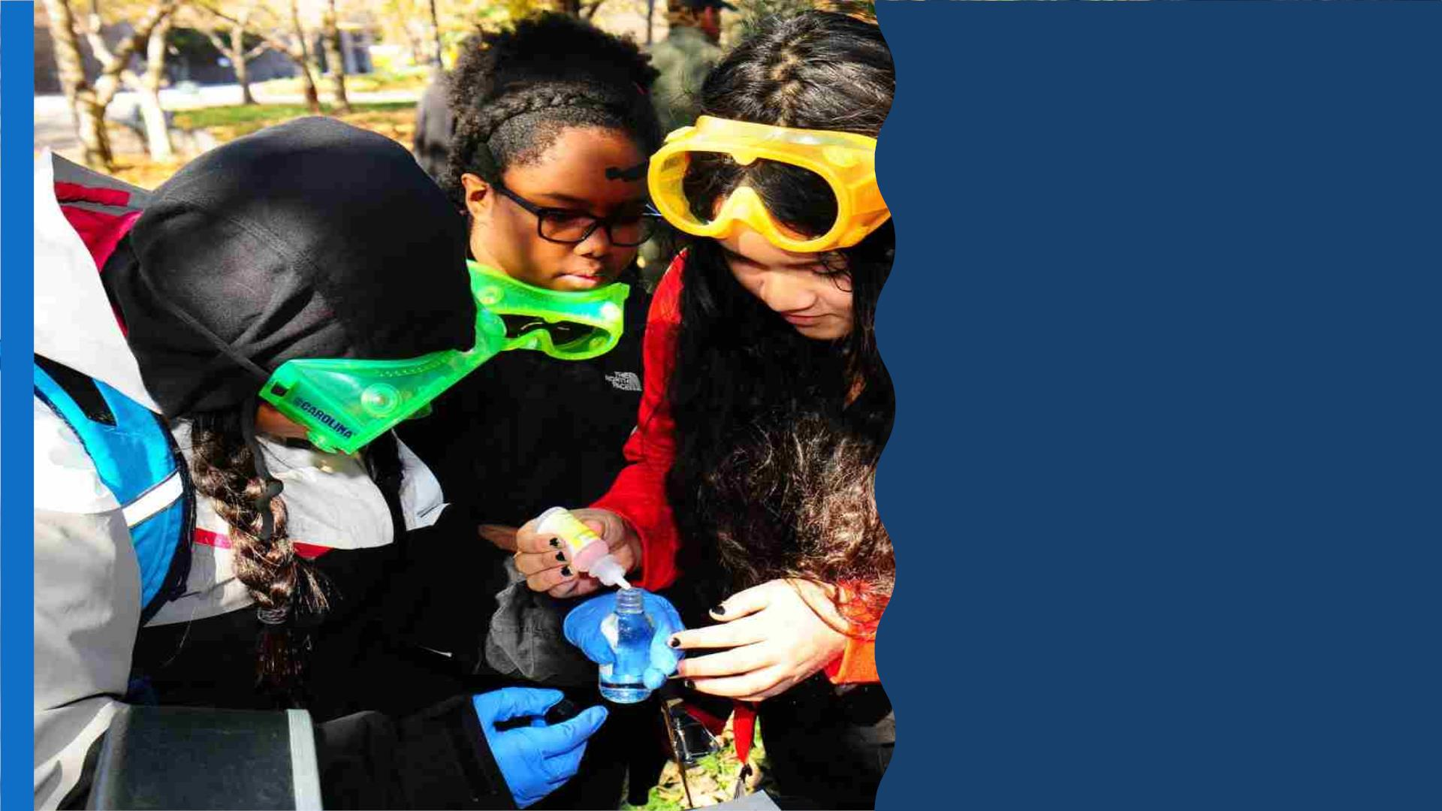
WATERSHED
WATCHDOGS
Assessing Water Quality
Test for 9 chemical parameters:
❑ Dissolved oxygen
❑ Nitrogen
❑ Phosphates
❑ pH
❑ Turbidity
❑ Temperature
❑ Fecal Coliform
❑ Biochemical Oxygen Demand
❑ Total Dissolved Solids

Slide 13
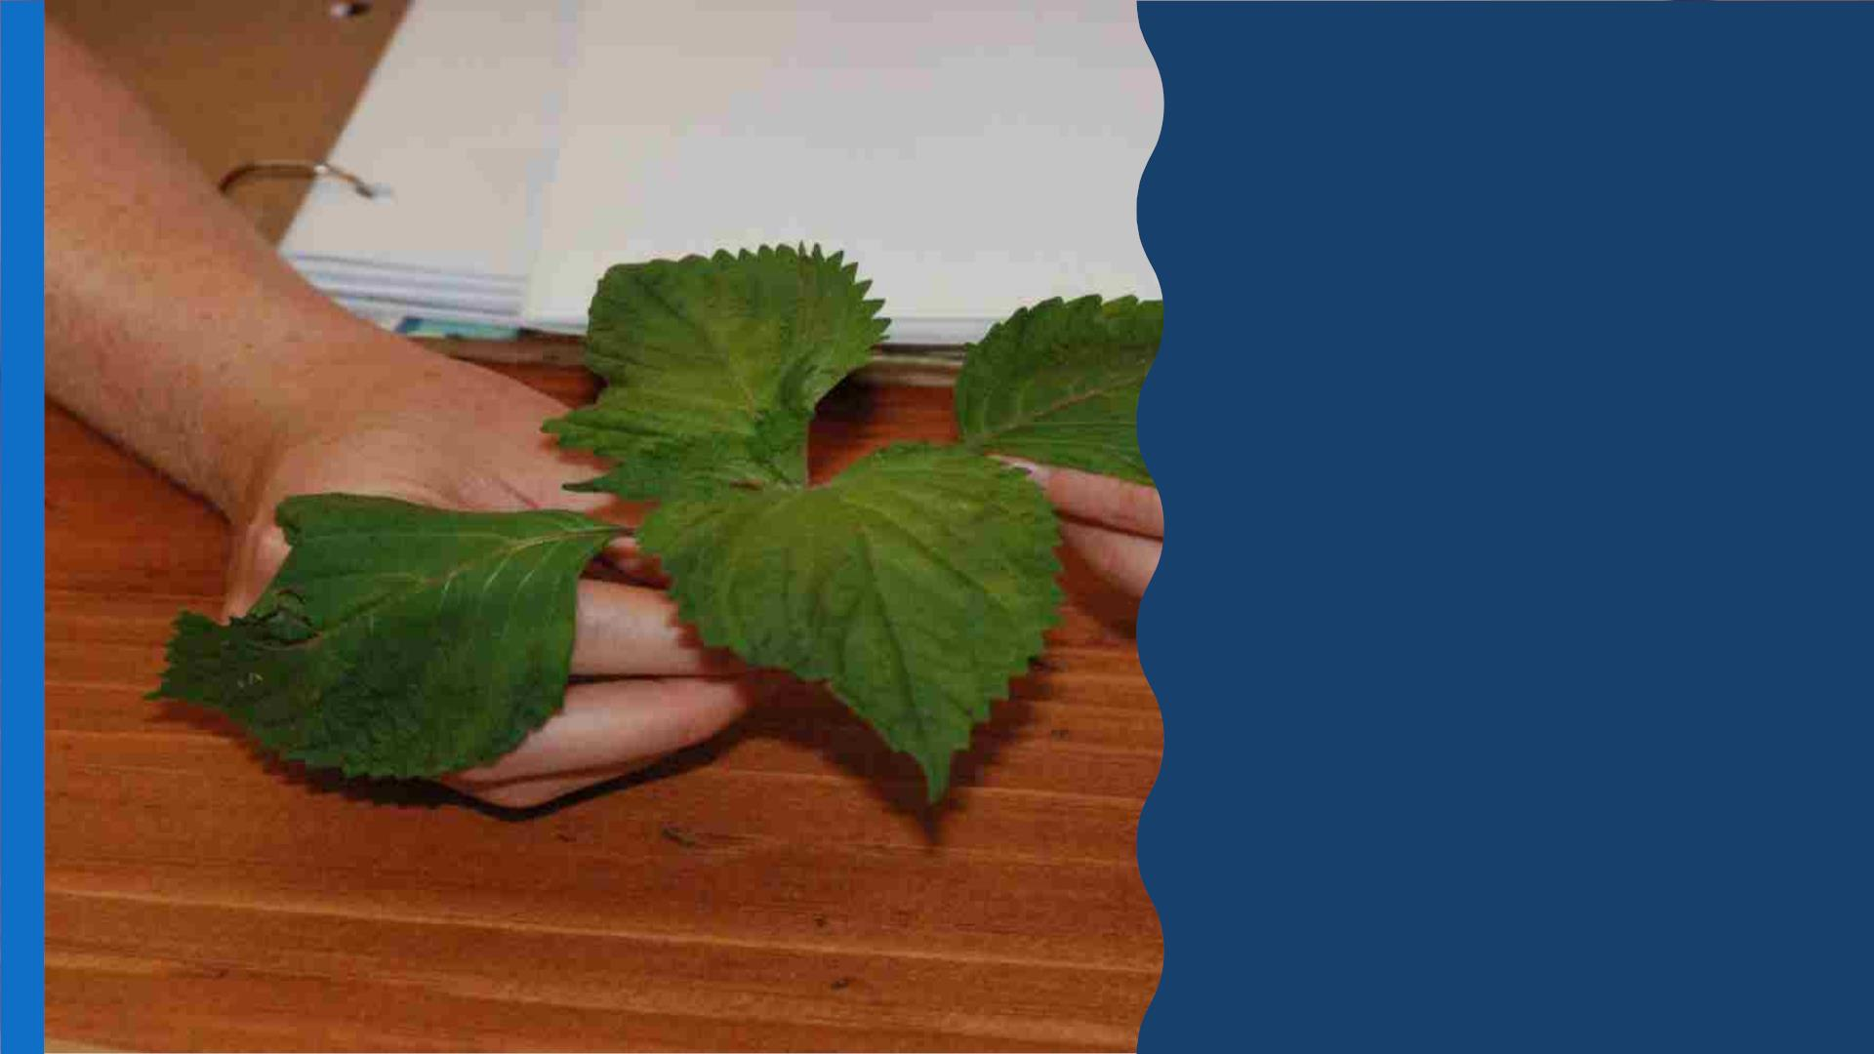
EXOTIC
INVADERS
Assessing Invasive Plant
Species

Slide 14
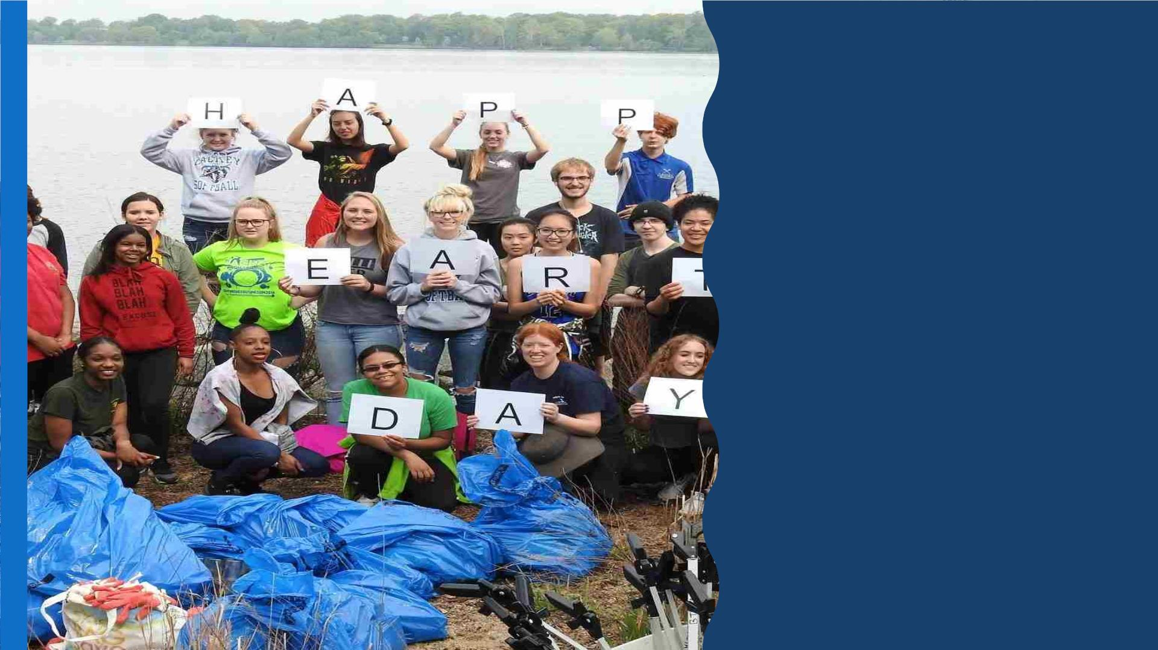
TALKIN’ TRASH
Assessing litter
Making inferences about
lifestyle and consumer
choices, and how these
choices have a lasting
impact on their watershed.

Slide 15
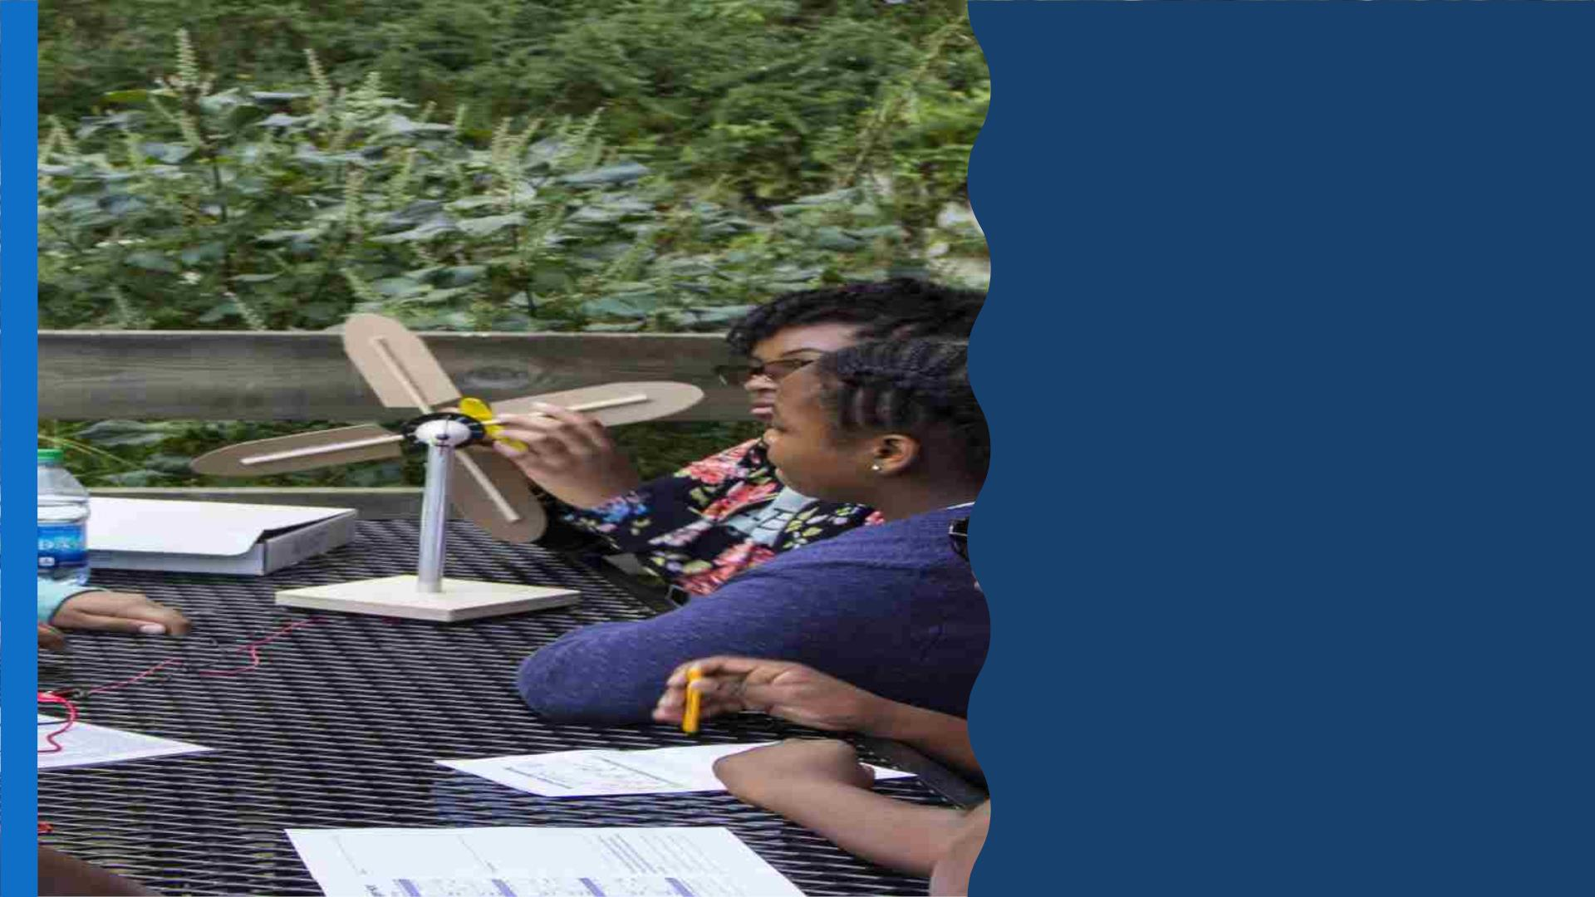
SUSTAINABILITY
Sustainable Site Design
Renewable Energy Design

Slide 16

THINGS TO CONSIDER
• How far is the park from the school location
• Transportation
• Once you pick a location fill out request form:
– Module(s)
– Three dates
– Two locations
– Approximate arrival and departure times
– Number of students

Slide 17
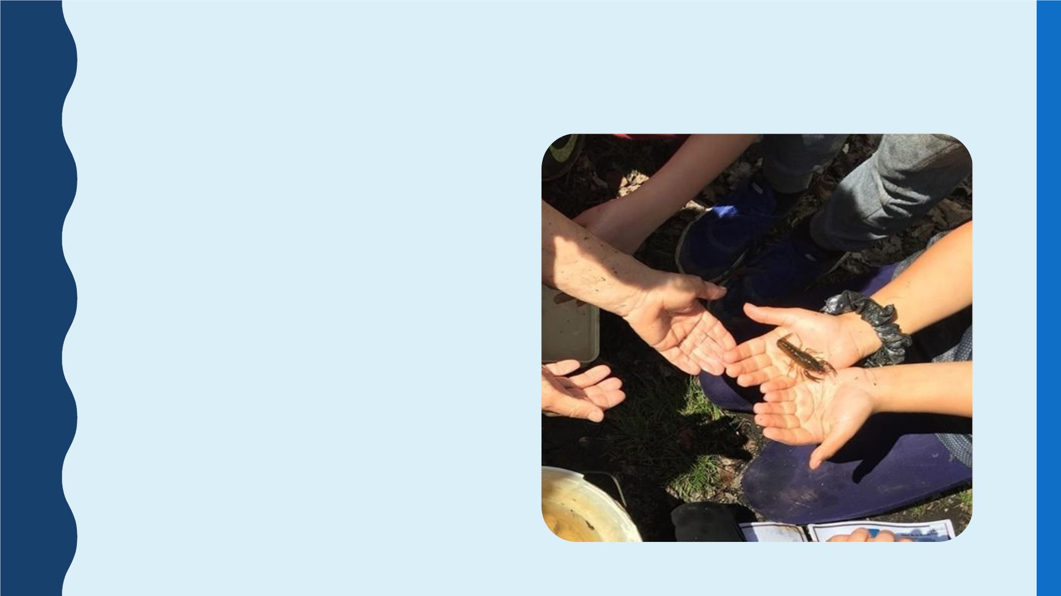
FIELD STUDY
• Approximately 4 hours
• Co-lead by ranger and AFF educator
• Hands-on science data collection
• Learn the history of a national park
• Lunch (optional)

Slide 18
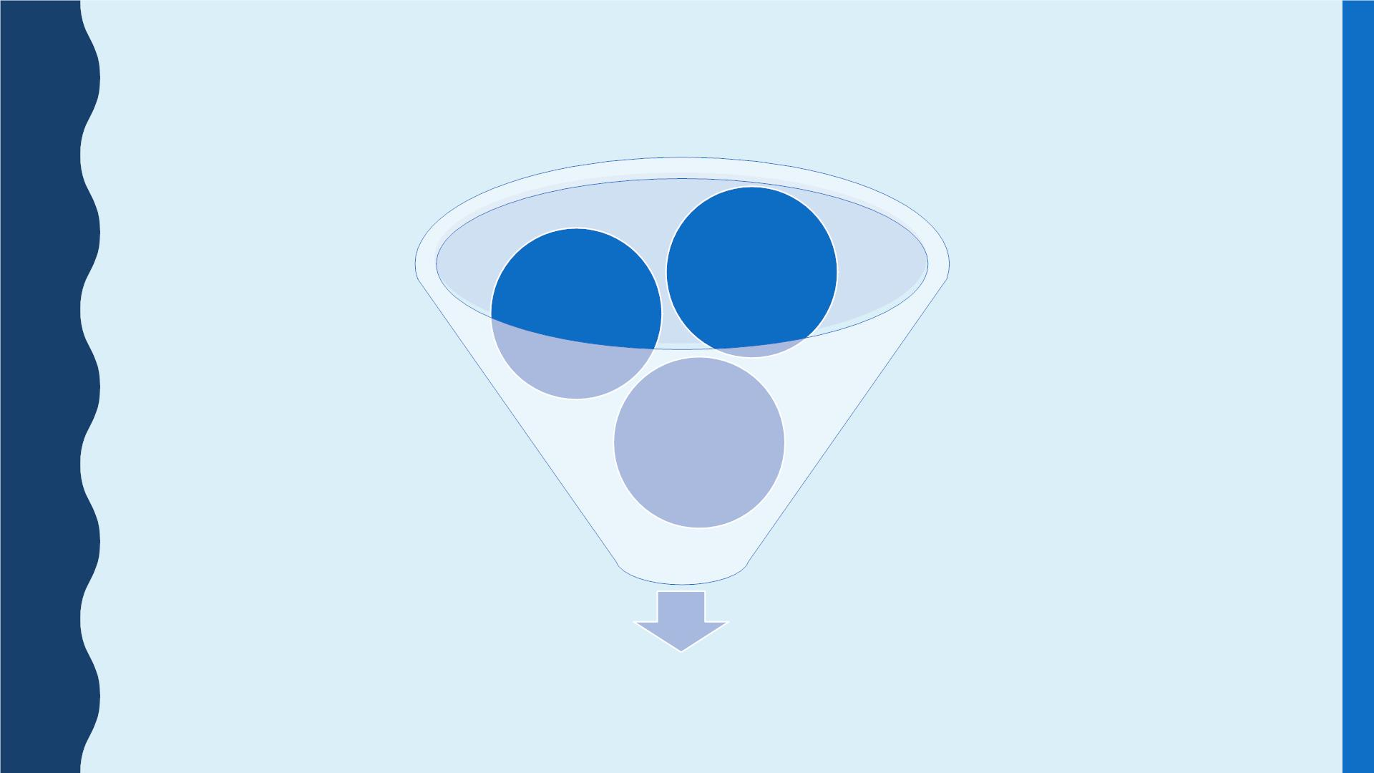
3 PARTS TO A SUCCESSFUL FIELD STUDY
Successful Field Study

Slide 19
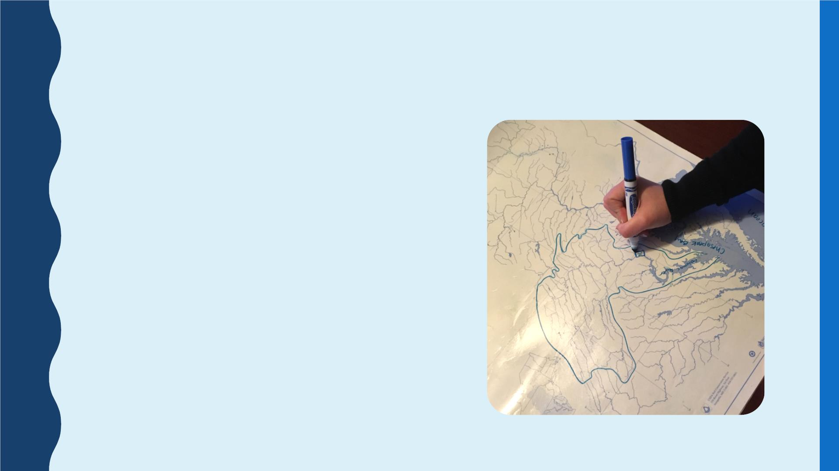
PRE-FIELD STUDY CLASSROOM
ACTIVITIES
• Engage students in science learning
• Ensure foundational knowledge

Slide 20
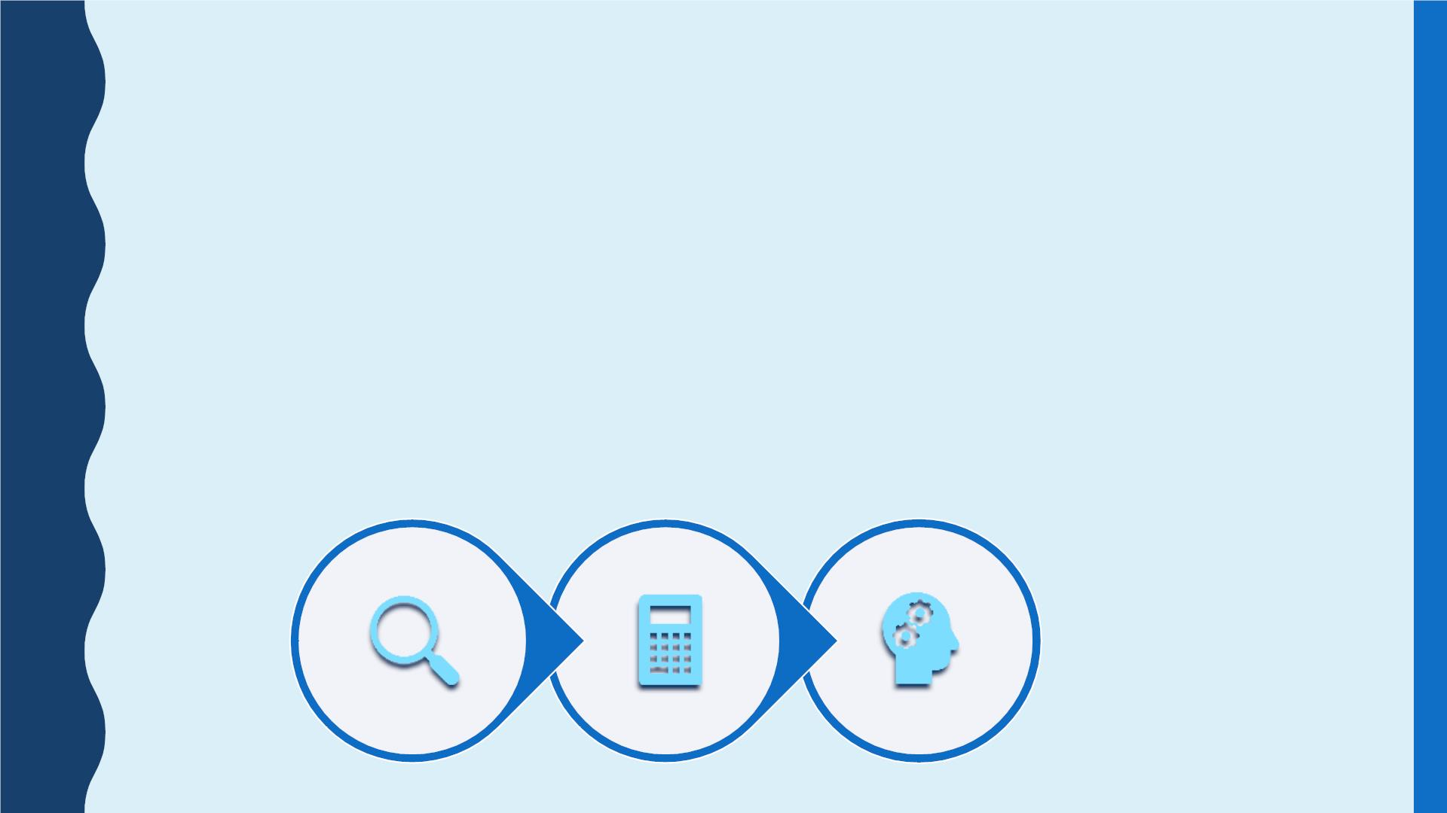
POST-FIELD STUDY AND CLASSROOM
DATA ANALYSIS
• Elaboration activity applies learning to a broader context
• Data is further analyzed back in the classroom
• Pre and post surveys are done at the field study
depending on module chosen
• Post activities done in classroom

Slide 21
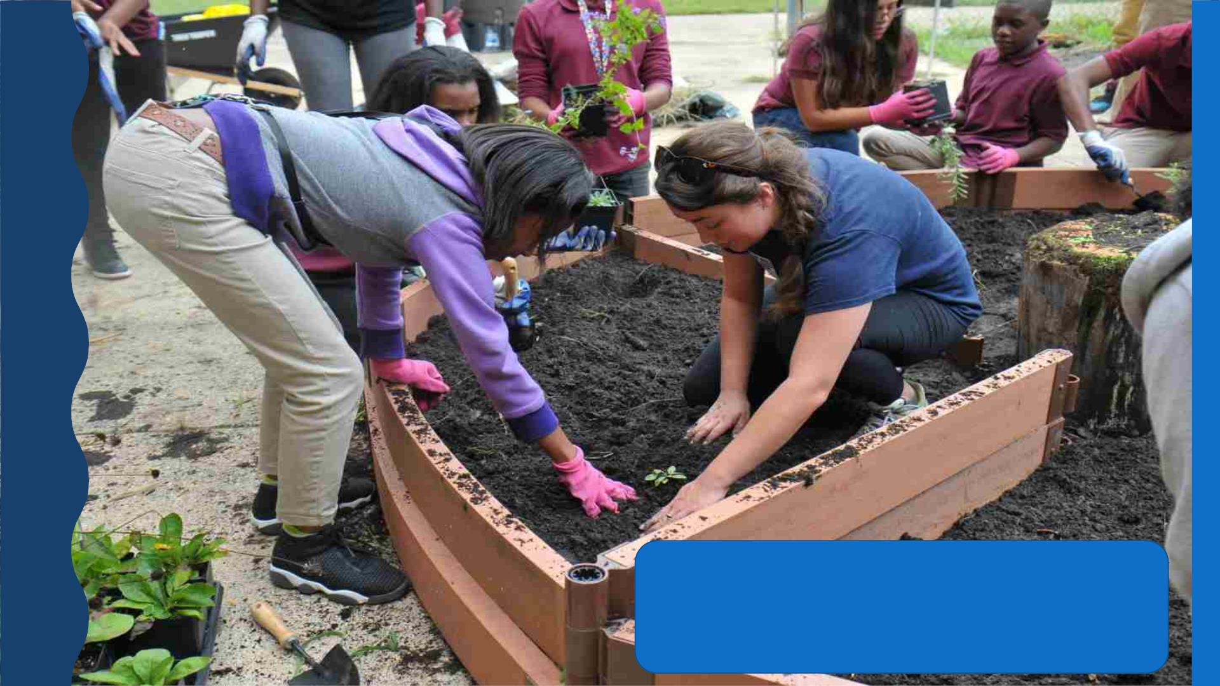
STUDENT ACTION

Slide 22

VIRTUAL PROGRAMS
1. Modules available
a. Water Canaries
b. Exotic Invaders
c. Sustainability
d. Talkin’ Trash
2. Virtual lesson to investigate how we study the issue and collect
data
3. Student data collection and reporting
4. Action project
a. civic action
b. watershed restoration
c. community engagement
d. everyday choices

Slide 23
