Slide 1

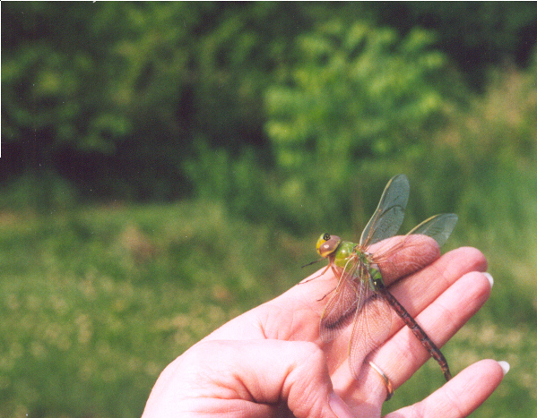
The Maryland
Green School Awards Program
www.maeoe.org

Slide 2
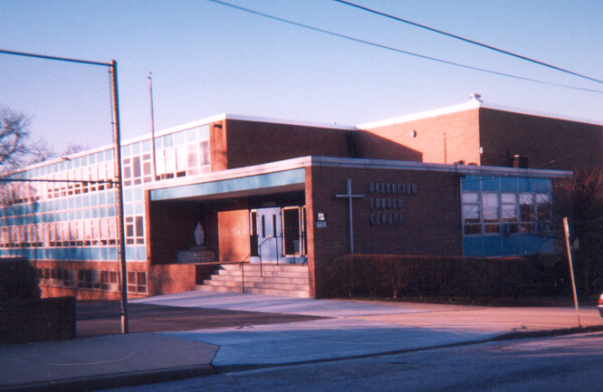
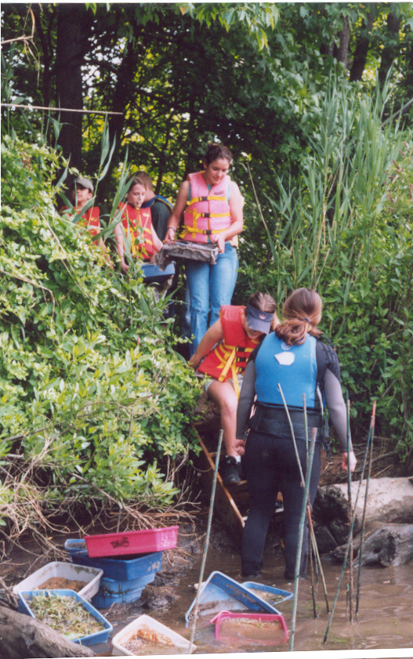
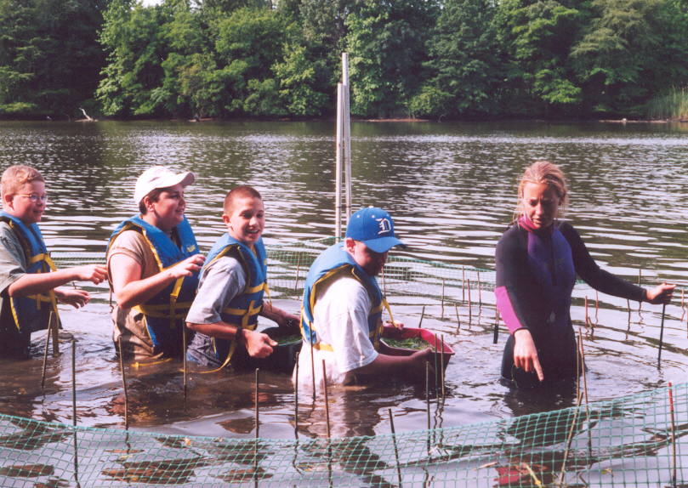
Ascension
Catholic School Halethorpe
Baltimore County
Maryland Green Schools
Use the curriculum, school, and community sites to investigate environmental issues and take action
Model Environmental Sustainable Practices
Build community partnerships for stewardship
Notes:
The Maryland Green School Model
Since 1999 the Maryland Green School Awards Program, sponsored by the Maryland Association for Environmental and Outdoor Education (MAEOE), has recognized Maryland public and private schools pre K-12 that:
Use their school site and curricular instruction to prepare students to understand and act on current and future environmental challenges facing all Marylanders.
Model environmental best management practices (BMPs) in building and landscape design, operation and maintenance.
Build and maintain partnerships with the local community to enhance environmental learning and to design and implement projects and programs that result in a healthier environment.
This bulleted list summarizes the main components of the Maryland Green School model.
Every Maryland school can operate as a Maryland Green School.
It is NOT about budgets or brand new buildings!
It IS about meaningful site-based education and identifying the opportunities that exist at your school.
Every school setting is unique and provides a special set of options.
This school sits on a concrete pad with limited opportunity for in-ground projects on the school property. They used their classrooms and local community sites for Green School projects.
Each Maryland Green School is unique in its setting and how it chooses to meet the requirements. However, in every case, the whole school participates.

Slide 3
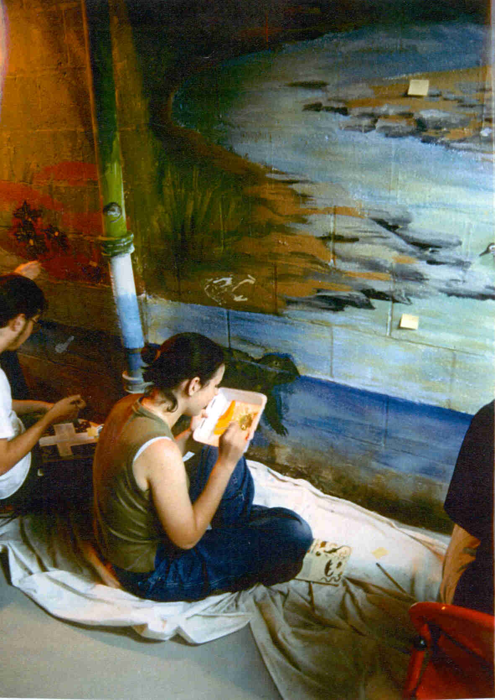
The MD Green School process
involves
all grade levels
and subject Areas
Art
Mathematics
Music
Creative and Descriptive Writing
Cultural Studies
Natural History
Horticulture
Reading
Science
Notes:
Maryland Green Schools use the environment as a tool for learning in all subject areas.
All grade levels are involved sometime during the school year.
It becomes the culture of the school.

Slide 4
5 great reasons to use the schoolyard, the school building, and the neighborhood as a classroom:
Provides alternative classroom settings
Engages students
Provides concrete learning opportunities
Provides authentic experiences
Increases success for all students
Notes:
There are important benefits associated with adoption of this teaching model
All students respond well to learning in a variety of settings
Students are engaged and see the lesson as relative to their lives.
Hands-on learning tends to be remembered.
Provides real-life opportunities to apply and extend classroom learning.
“Levels the playing field” for all students, especially those who learn best in authentic settings.

Slide 5

Getting Started
Contact your Green Center
Establish your school’s Green Baseline. Make a list of all Green activities from the past two years.
Set up a Weebly or Power Point to capture your information during the application process.

Slide 6

The MD Green School Application Pre K-12
Summarize the school’s actions over 2 years. Provide documentation.
1. Systemic Sustainability
    Demonstration of hands on, real world instruction of environmental issues
    Professional Development
    Celebration
2. Design, Operation, and Maintenance of
School Building and Site (2 Actions from at least 4 SPs)
    Water Conservation/Pollution Prevention
    Energy Conservation
    Solid Waste Reduction
    Habitat Restoration
    Outdoor Structures for Learning
    Responsible Transportation
    Healthy School Environment
3. Community Partnerships, Awards & Recognition
Notes:
These are the 3 basic components of the Maryland Green School application for schools.
MD Green Centers must assist schools in meeting these requirements, model best management practices, and enter into community partnerships.
Note: As a worksheet, you may want to handout the basic one-page MD Green School Application Guide. Teachers and students can use it to note actions already accomplished and identify work yet to be done.
The following slides give examples and provide ideas for meeting the requirements.

Slide 7
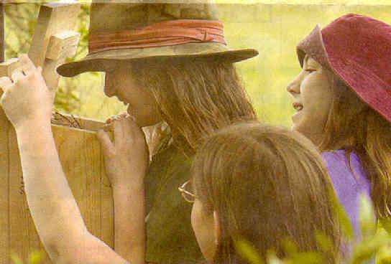
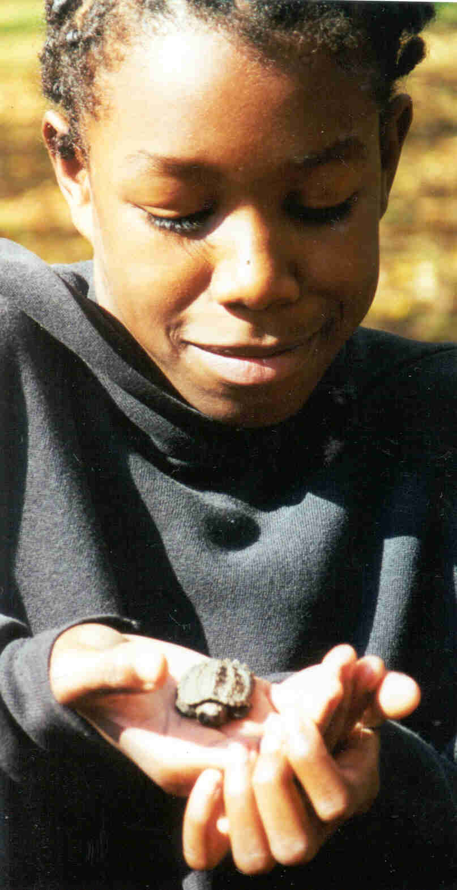
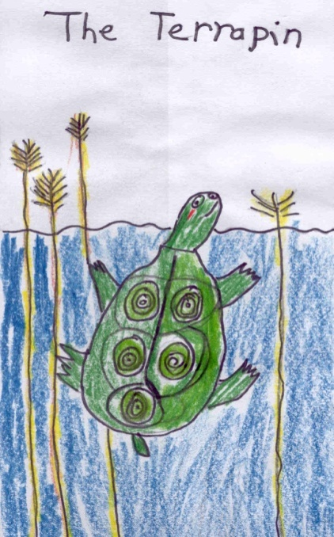
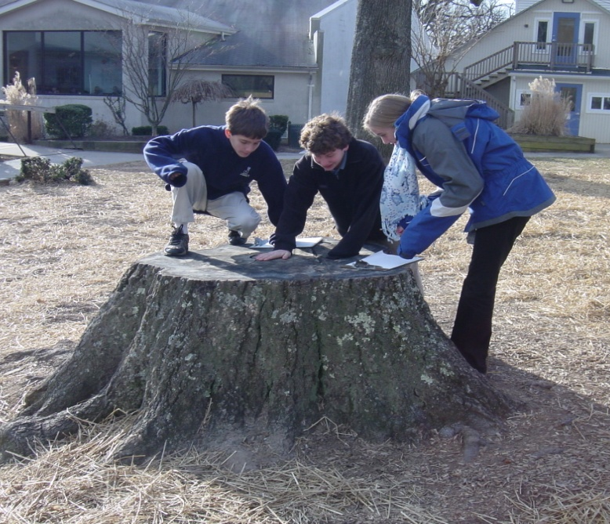
Making Curriculum Connections
and
Investigating Environmental
Issues
Using the schoolyard and local watershed as a classroom
Notes:
Making curriculum connections across disciplines and grade levels
Environmental issue instruction
Using student artwork as documentation

Slide 8
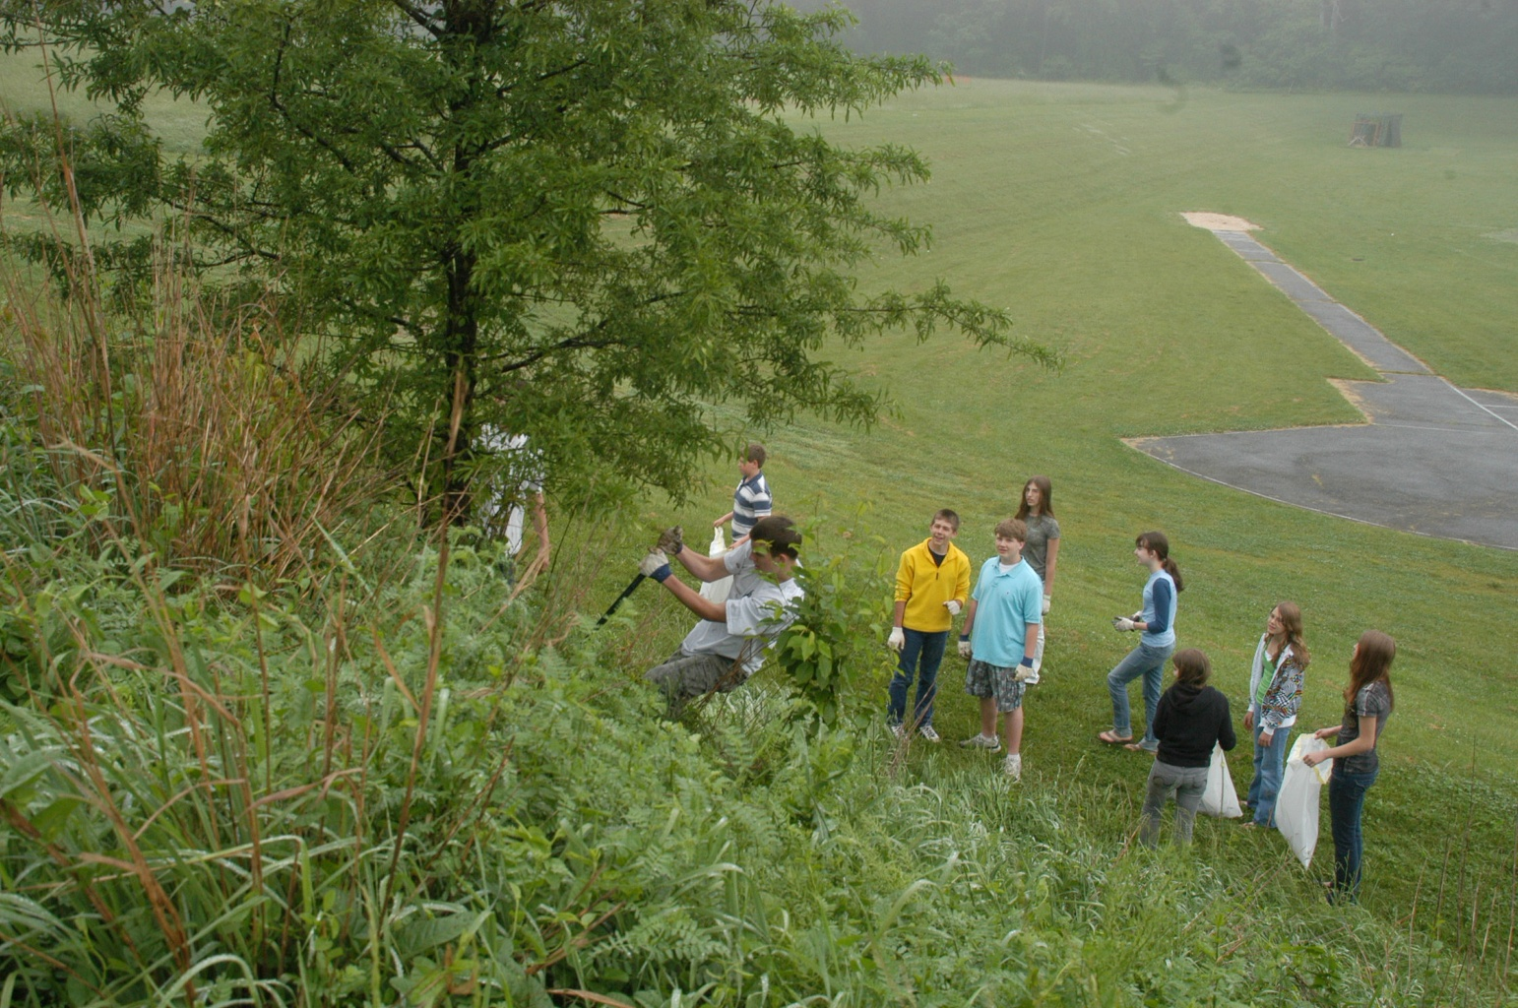
Student Sustainable Practices (SPs)
Annual clean-up of an existing no-mow zone

Slide 9
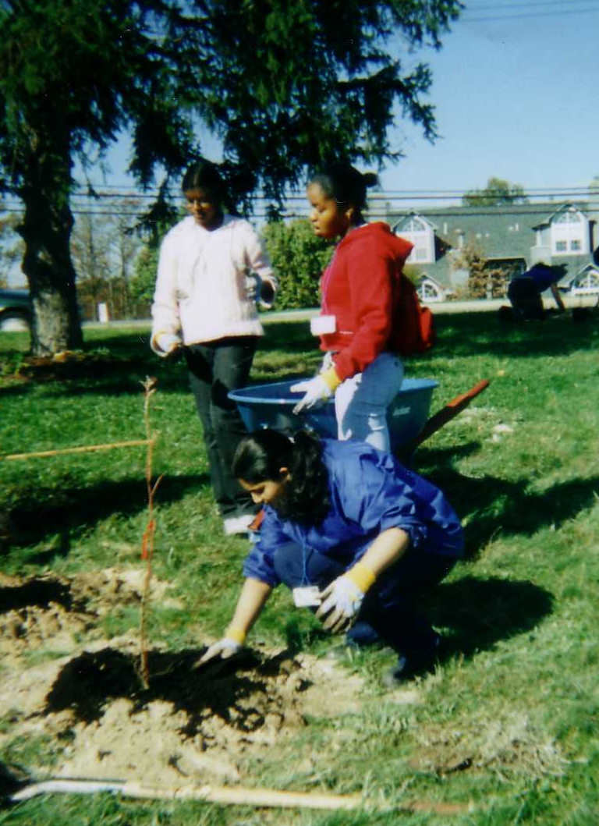
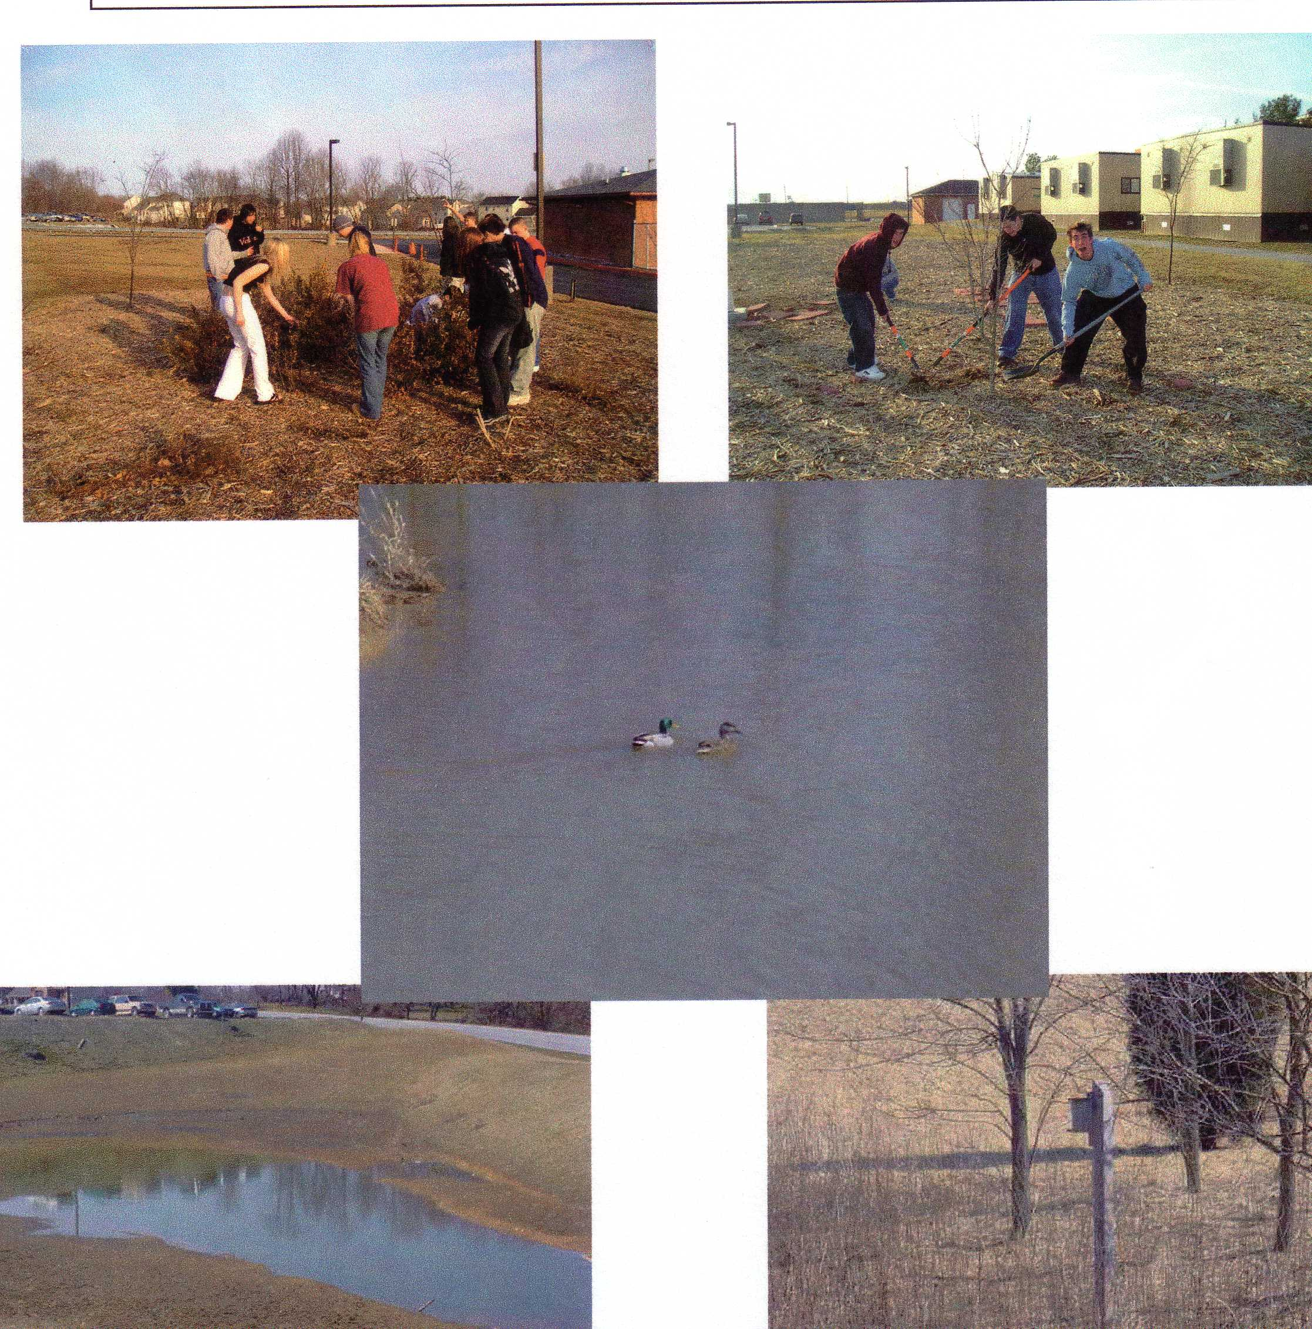
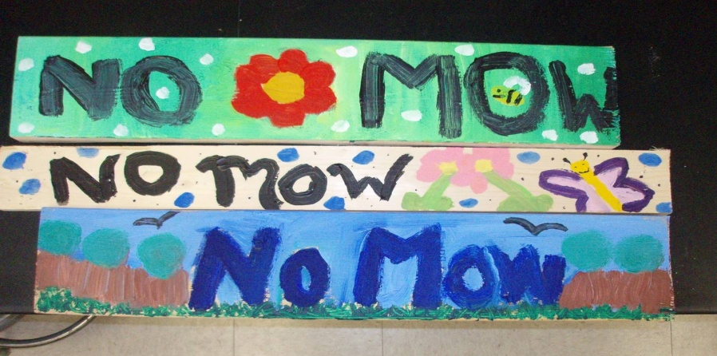
SP #1 Water Conservation
Water Pollution Prevention
Planting trees and shrubs and creating “no-mow” zones
are two ways to slow storm water runoff,
trap nutrients, and control soil erosion.
Notes:
Tree plantings have many benefits including stormwater management and erosion control.
g
Middle and high school students can teach elementary students and parents how to plant and maintain.
Some schools label the native trees, shrubs, and the troublesome invasive plants on their campus.
“No-Mow” zones, as well as other outdoor projects may be used as extensions of classroom learning.

Slide 10

SP #2 Energy Conservation
After
investigating
energy use
at school,
students and
their families
conducted an
energy audit
at home.
Identify and STOP “phantom” energy losses.

Slide 11
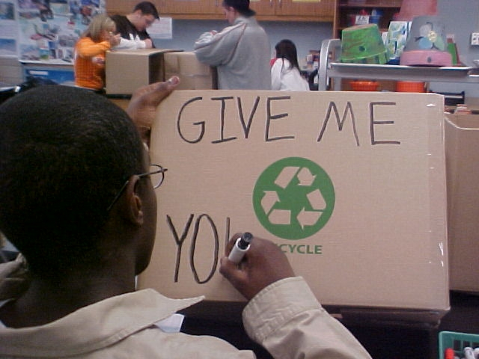
SP #3
Solid Waste Reduction
Print double-sided
Buy products with no packaging or with wrapping that can be reused or recycled.
Recycle ink cartridges
Set up outdoor composting
Plan an indoor or outdoor
clean-up day
Arrange for curb-side pick-up of recyclables
No-waste lunch days
Reduce - Reuse - Recycle
Notes:
Examples of what some schools have accomplished for this BMP

Slide 12
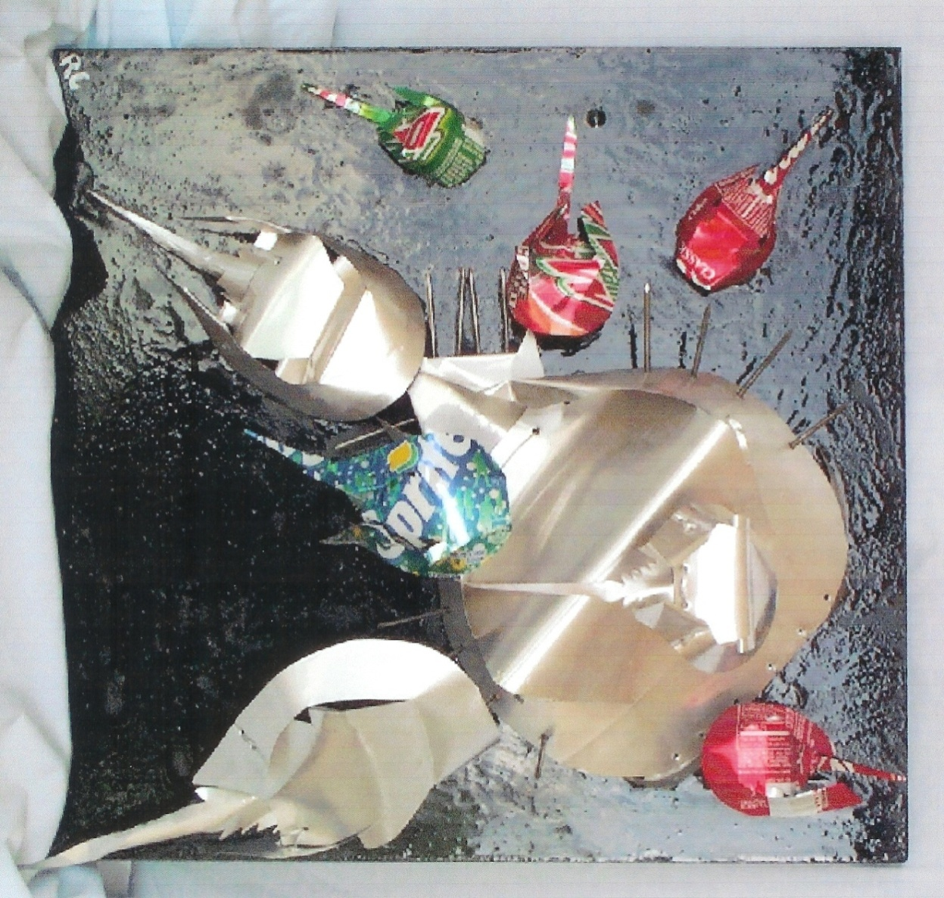
Solid Waste
Reduction
Reduce
Reuse
Recycle
A great example of
cross-curricula
connections
Horseshoe crabs made from cans and other reused materials
Notes:
One example of an art connection.

Slide 13
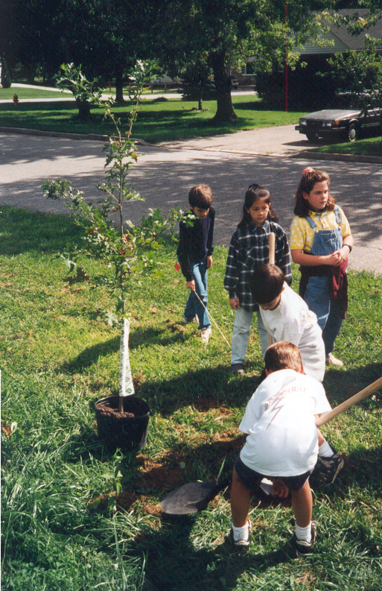
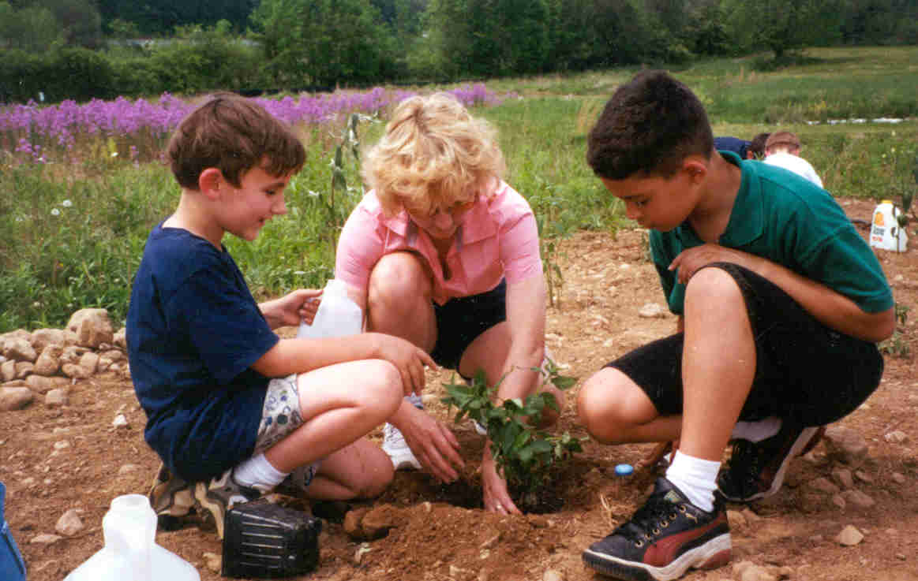
SP #4
Habitat Restoration
Students share
the challenge of planning and
the fun of installation.
They evaluate the results and
maintain the project
for the long term.
Notes:
Schoolyard habitat restoration projects could involve:
- Planting native trees, shrubs, and perennials for food and cover
- Erecting bird, butterfly, or bat boxes
- Removing turf or impervious paving and introducing native plants
- Constructing brush piles or saving snags and downed tree logs
MAEOE’s Schoolyard Habitat Partnership Program and the Chesapeake Bay Trust can be good partners.
Invite parents, local businesses, and watershed organizations to join in and help.

Slide 14
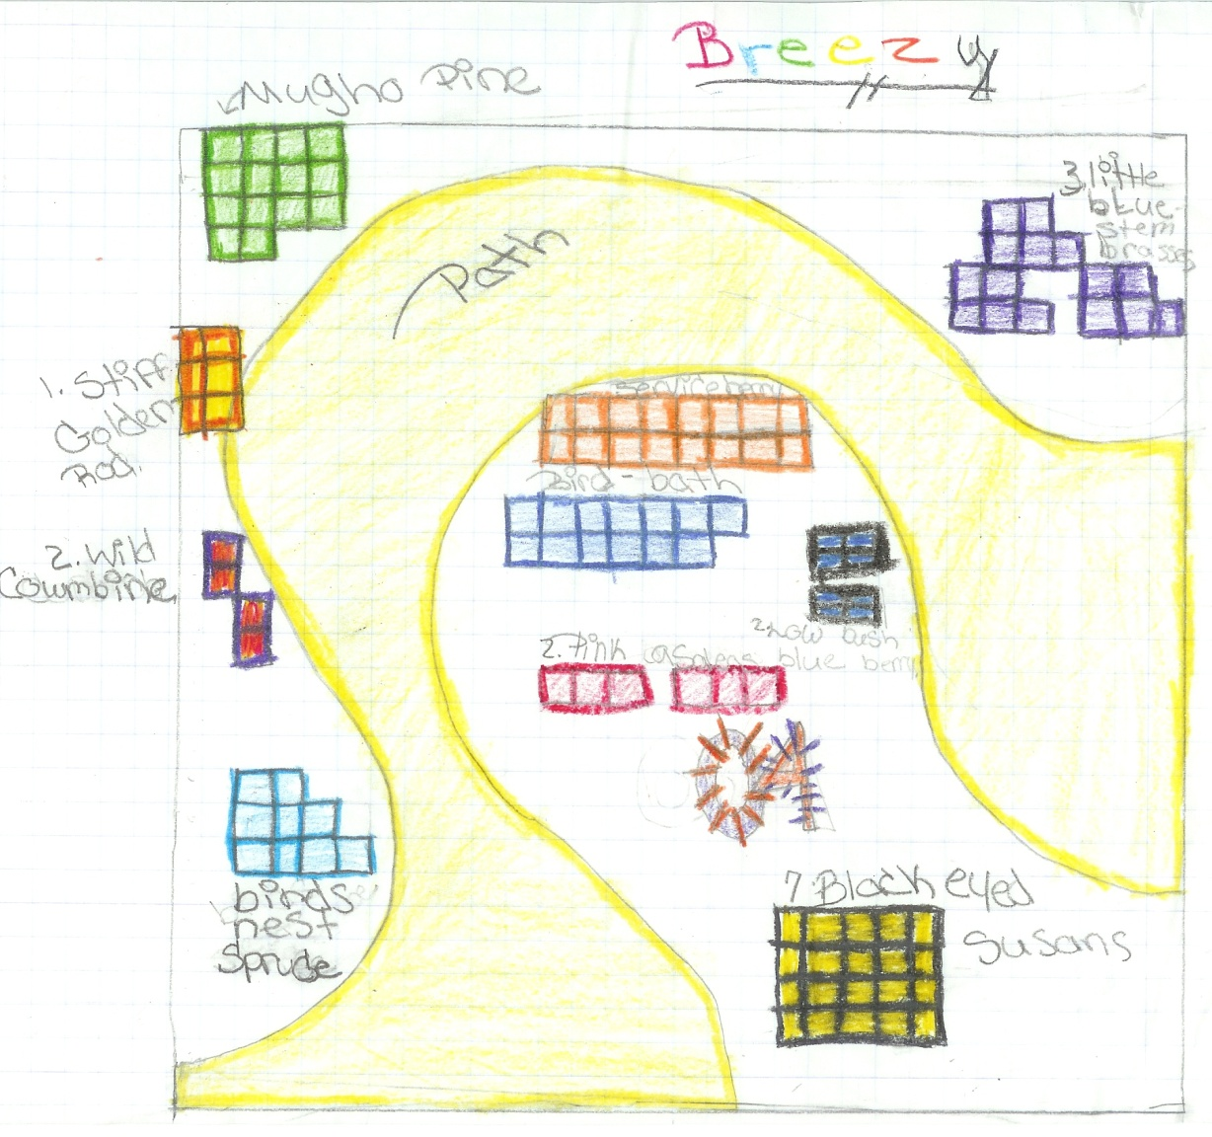
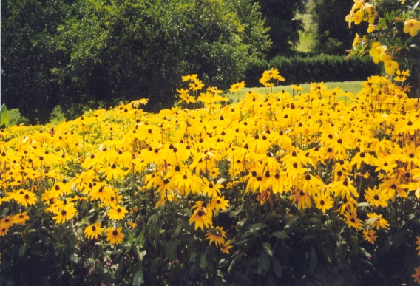
What, where, and how: Habitat Restoration
Students conduct
site assessments
and plan
schoolyard habitat
projects.
Student work
makes
excellent
documentation.
Design components add diversity
and provide food and cover
Notes:
Because of the wide variety of curriculum connections, the a fun involved, and the environmental benefit, most schools applying for MD Green School recognition have chosen this Best Management Practice (BMP) to report.
Student work can be used as documentation.
Students can help prepare the GS application.

Slide 15
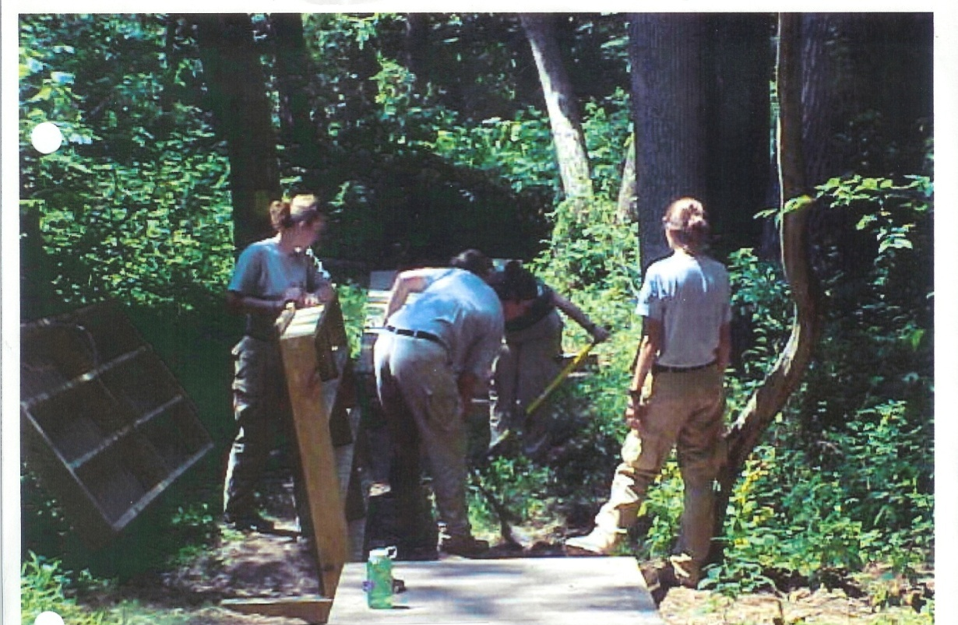
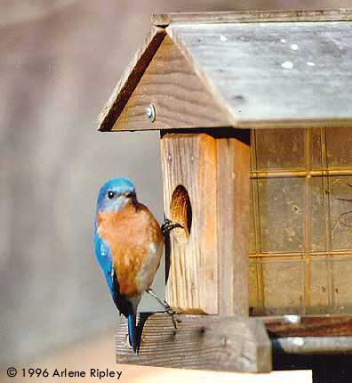
SP #5 Building Structures for Learning
Boardwalks
Nature trails
Informational signs
Wildlife viewing blinds
Bird, bat, and butterfly boxes
Outdoor Classrooms: Built-in or moveable
Native Maryland tree ID tags
Outdoor art: sculptures, murals
“Green Building” components
Notes:
Structures might include:
Informational signage
Tree/plant identification
Wildlife viewing blinds
Outdoor classrooms (permanently installed or moveable “bucket seats”)
Birdhouses
Bathouses, etc.

Slide 16
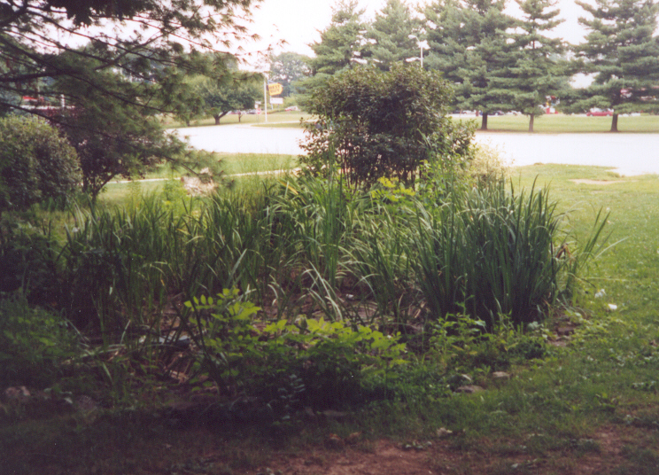
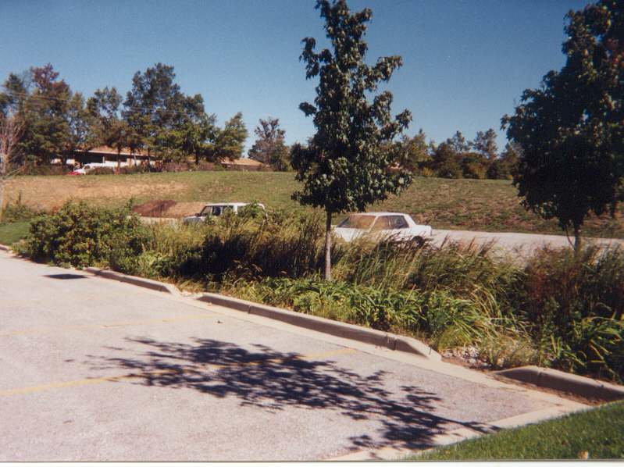
SP #6 Responsible Transportation
Paved parking lots can contribute to polluted storm water runoff
Rain gardens
Are designed for bio-retention
Other ideas:
If paving is old, cracked, or no longer needed, substitute pervious pavers or planted areas.
To improve air quality, some schools set up “no-idling” zones and special carpool lanes.
Notes:
Projects might include:
Raingardens to slow down and bio-retain parking lot runoff
Pervious paving
Carpool plans
Bicycle safety programs and bike lanes

Slide 17

SP #7 Healthy School Environment
What could students do?
Help keep it clean! De-clutter
Test school drinking water
Monitor for air flow, temperature, excess moisture, and mold
Invite animals and pets to “visit” rather than live in the classroom
Grow indoor plants to improve school air quality
School Gardening
Schoolyard and/or Community Clean Up (e.g. Potomac Watershed Clean Up)
Host a Recycling Olympics or Green Run
Notes:
Indoor Air Quality (IAQ) factors have been shown to affect student achievement.
Once problems are identified, many solutions require budgetary decisions and are the responsibility of the facilities staff.
However, students and teachers who know what to look for, can alert facilities staff and assist them in maintaining healthier places to learn.
The EPA website is a good source for more information.

Slide 18
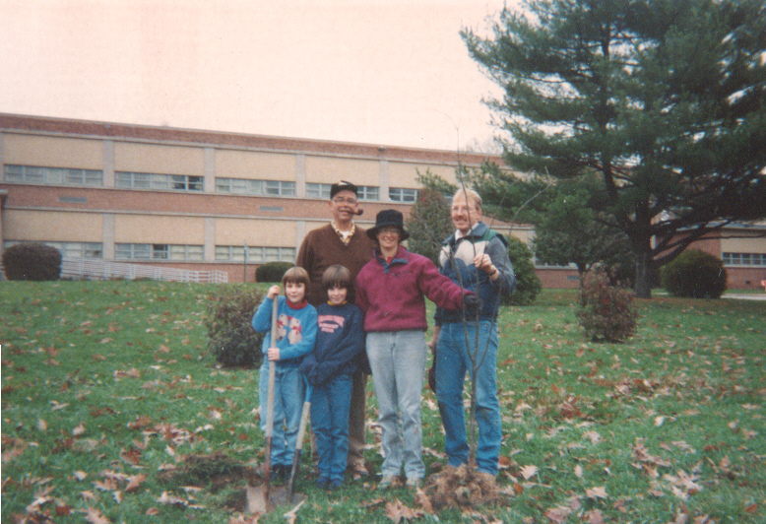
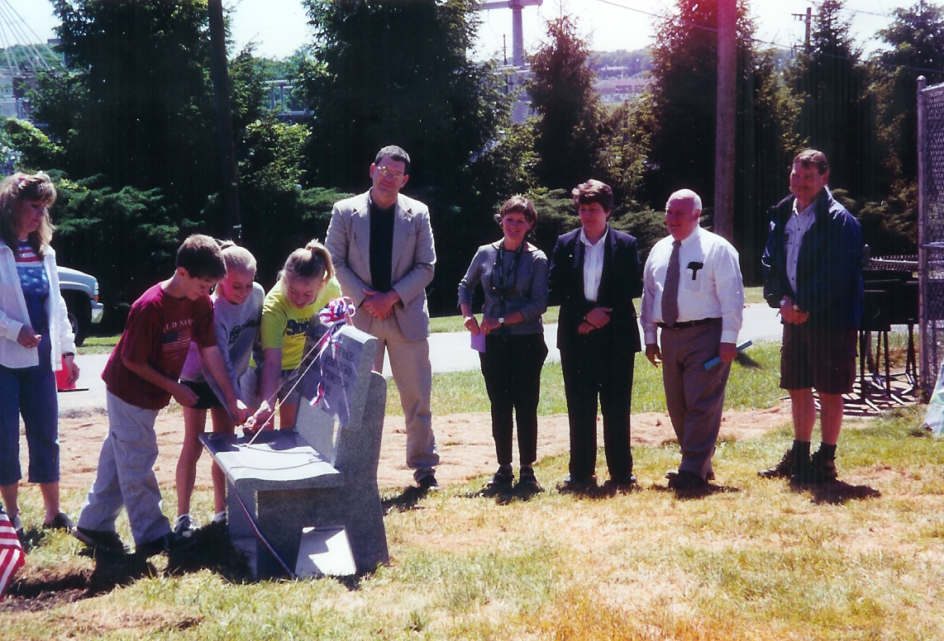
MAEOE
Parents and PTA
MD Green Centers
Forestry Board
Chesapeake Bay Trust
Local county agencies
MD DNR, MDE, MSDE
Colleges and Universities
Non-profit groups
UMD Cooperative Extension
Local garden clubs
Local businesses and organizations
Federal agencies/EPA
RESOURCES
and
COMMUNITY
PARTNERS
Notes:
Green Schools don’t operate in a vacuum!
They work with community partners to enhance the school’s program or accomplish projects in the community.
There’s plenty of help out there!

Slide 19
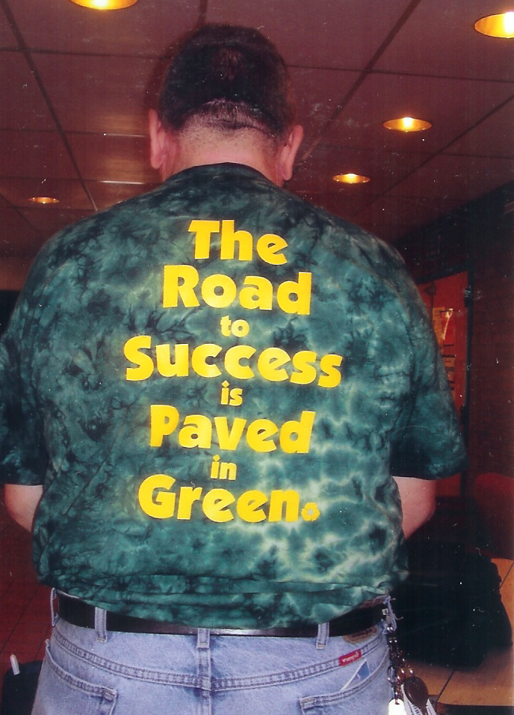
How to get started…..
  Assemble a Green School Committee at your school
Identify the curriculum connections and the actions you’ve already accomplished
Complete all requirements
Document your actions
Submit by the deadline
Celebrate!
Notes:
How to get started towards operation as a MD Green School

Slide 20


Maryland’s Green Schools
Highly visible models
for other schools and for the community
Once earned,
the designation
lasts 4 years
Rewards
and
Incentives
Re-application:
a renewing and energizing process
→
→
Notes:
Becoming a MD Green School is like “walking through a portal”. It changes the culture at your school.
Its not the kind of award that you get, say hooray! and then go and do something else.
In the days, months, and years ahead, the students benefit from authentic site and community–based learning.
The school operates in distinctly sustainable ways and serves as a model for other schools and the community.

Slide 21
MD Green Schools* by county/city
Current as of Spring 2016
MD Green Schools
Allegany | 1 | Harford | 16
Anne Arundel | 66 | Howard | 50
Baltimore | 30 | Kent | 1
Baltimore Co | 59 | Montgomery | 81
Calvert | 22 | Prince Georges | 75
Caroline | 1 | Queen Anne’s | 6
Carroll | 17 | Somerset | 1
Cecil | 6 | St. Mary’s | 17
Charles | 10 | Talbot | 3
Dorchester | 0 | Washington | 8
Fredrick | 2 | Wicomico | 2
Garrett | 5 | Worcester | 1
*Supported by 39 Maryland Green Centers
Notes:
Current distribution of MD GS statewide since 1999

Slide 22
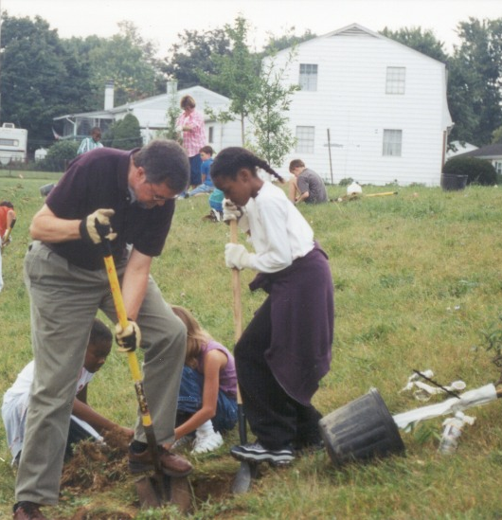
What do we get for our efforts?
Excitement! Fun!
A chance to learn outside.
An opportunity to tackle
authentic, real-world problems.
Project partnerships that
demonstrate by example.
School projects that provide air
and water quality improvement.
Students see the impact of their actions…..leading to measurable results.
Demonstrated improvement on test scores.
Recognition!
Notes:
The benefits are two-fold: to the environment itself as the projects are completed, and to the education of students as they work on those projects.
Every community benefits when a local school becomes a MD Green School:
Note the partial list of community benefits listed in the green box on upper right or the slide.
Most importantly, note the bulleted list of benefits to schools and individual students below the picture.

Slide 23


Without a Doubt…
Kids are interested!

Slide 24
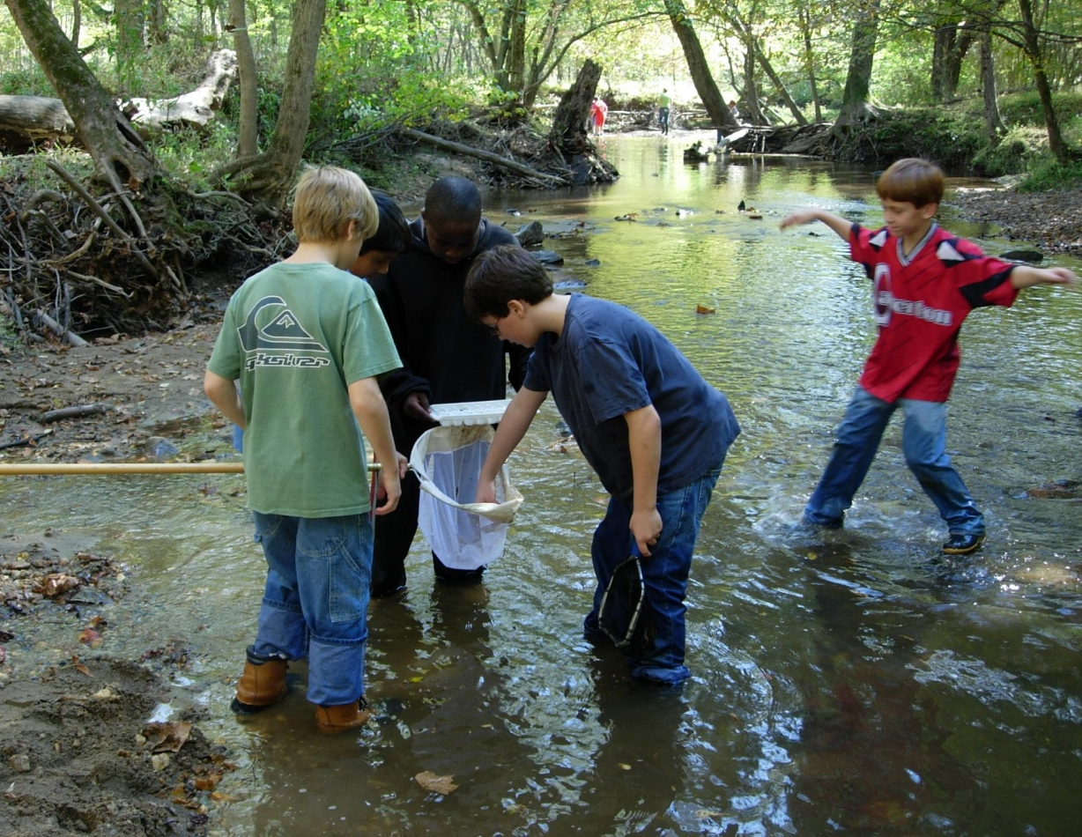
The Maryland
Green School Awards Program
Does your school
do what a
MD Green School does?
www.maeoe.org
greenschools@maeoe.org
temhoff@ccboe.com
Questions?
Notes:
Time for Q/A and discussion as to where schools represented in the audience are in the process?
What specific help do they need?

