Slide 1
Alice Ferguson Foundation’s
Bridging the Watershed
Watershed Watchdogs
UNDERSTANDING THE
WATER QUALITY INDEX (WQI) PARAMETERS

Slide 2
Potomac River Watershed
14,700 square miles
Four States + DC
5.8 million people

Slide 3
HISTORY OF THE POTOMAC RIVER
1810
The first sewer system in Washington D.C. carries waste to the nearest stream
1950
Disposable containers widely used
1938
Blue Plains Wastewater Treatment Plant completed
1932 River closed for swimming for 13 miles in lower Potomac
Notes:
Closed due to heavy bacterial contamination from untreated wastes

Slide 4
HISTORY OF THE POTOMAC RIVER
1951 The Washington Post calls the Potomac River “an open sewer.”
In the 1960’s, President Lyndon B. Johnson declared the Potomac River a “national disgrace.”
1973 Sewage outflow into Potomac River
1973 Potomac River algae bloom

Slide 5
CLEAN WATER ACT (1972)
Relying solely on the states to address water pollution, viewed largely as a state and local problem, wasn’t working.
Made it unlawful to discharge any pollutant from a point source into navigable waters, unless a permit was obtained
EPA works with its federal, state and tribal regulatory partners to monitor and ensure compliance with clean water laws

Slide 6
The clean water act has been successful at reducing pollution that enters our rivers and lakes from point sources.
Nonpoint source pollution is still a significant problem for clean water.
Point Source
Single, identifiable sources like wastewater treatment plants and factories
Nonpoint Source
When precipitation flows over landscape and picks up pollutants from farmlands or city streets on way to river

Slide 7
If we can’t trace the specific source of pollution, how can we possibly stop it?
Frequent Water Testing
Ecology Knowledge
Aware Public
Clean Water
Notes:
Ecology knowledge: we know which substances decrease water quality through ecology knowledge
Through water quality testing we propose what contaminants may be present

Slide 8
PARAMETERS
Dissolved Oxygen
Biochemical Oxygen Demand
Change in Temperature
Fecal Coliform
Orthophosphates
Nitrates
pH
Turbidity
Total Dissolved Solids

Slide 9
DISSOLVED OXYGEN (DO)
% saturation of gaseous oxygen dissolved in water
Importance
Acceptable Levels
Fish, invertebrates, plants, and aerobic bacteria require oxygen for cellular respiration.
80-125% or
>5mg/L
Units of Measure
How is it introduced:
Gaseous oxygen dissolves at
surface where air and water meet
Riffles
Aquatic plants
% saturation or mg/L
Notes:
High turbidity means less sunlight can reach SAVs and photosynthesis rates slow down. Less O2 is produced.
The same way a paper towel can only hold so much water, water can only hold so much O2 – it has an oxygen saturation point. The higher the temperature, the less O2 the water can hold.
Decreased SAVs mean less photosynthesis potential. Less O2 is produced.
Sources: https://www.epa.gov/national-aquatic-resource-surveys/indicators-dissolved-oxygen
Graphic from: https://www.epa.gov/sites/production/files/2015-09/documents/2009_03_13_estuaries_monitor_chap9.pdf

Slide 10
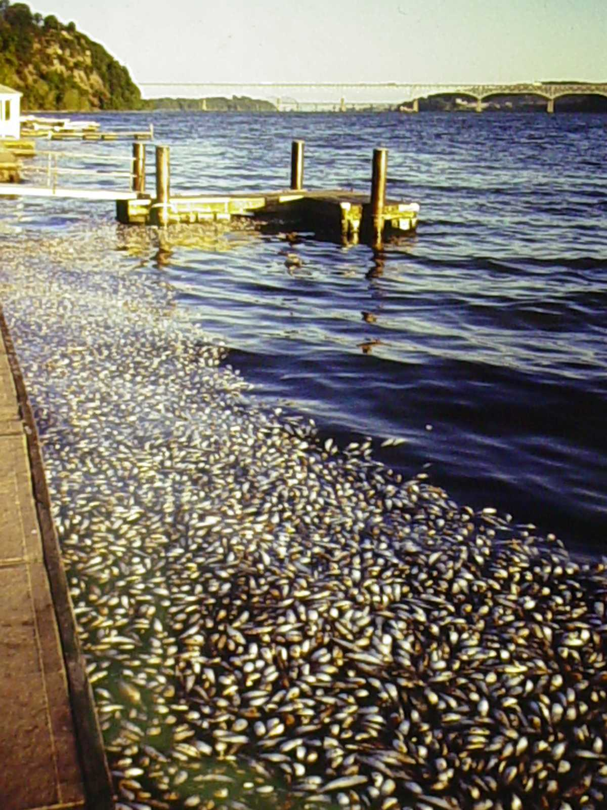
Low DO levels are the 3rd highest cause of fish kills in MD
Notes:
Low DO levels are the 3rd highest cause of fish kills in MD, leading to nearly 600 incidents in the past 20 years.
Most Maryland fish kills occur in estuaries.
Out of 2400 fish kills in the past 20 years, here are some highlights, by county:
Anne Arundel – 450
St. Mary’s - 119
Prince Georges – 99
Montgomery - 88
Carroll - 85
Charles –84
Frederick – 78
Source: MDE website
http://www.mde.state.md.us/Programs/MultimediaPrograms/environ_emergencies/FishKills_MD/index.asp

Slide 11
BIOCHEMICAL OXYGEN DEMAND
Quantity of oxygen used by bacteria to decompose organic matter
Lower amounts of available oxygen limit aquatic life to organisms highly tolerant of low oxygen levels
Importance
Acceptable Levels
8-150
mg/L
Excess organic matter in the water
Algae blooms
Raw sewage
Units of Measure
Caused by:
Notes:
When too much organic matter is in the water, the living matter eats nutrients and the dead matter breaks down when bacteria use oxygen to decompose it. So, if there are excess nutrients that cause algal blooms (which then die) or if there is a lot of raw sewage (organic waste) dumped in the water, LOTS of decomposition happens and too much oxygen gets used up (eutrophication). Eutrophication can cause other aquatic organisms to suffocate!
Source: https://www.epa.gov/sites/production/files/2015-09/documents/2009_03_13_estuaries_monitor_chap9.pdf
Accessed 1/13/17

Slide 12
TEMPERATURE CHANGE
Difference in temperature between two different locations in a stream
Importance
Warm water holds less oxygen than cold water.
Organisms can’t tolerate sudden temperature fluctuations.
Acceptable Levels
< 5°C change in less than one mile length
° Celsius
lack of stream bank vegetation
Impound water (like a dam)
Runoff from impervious surfaces such as parking lots
Discharged heated water we have used for cooling
Units of Measure
Caused by:
Notes:
Warm water holds less dissolved oxygen than cool water, and may not contain enough dissolved oxygen for the survival of different species of aquatic life.

Slide 13
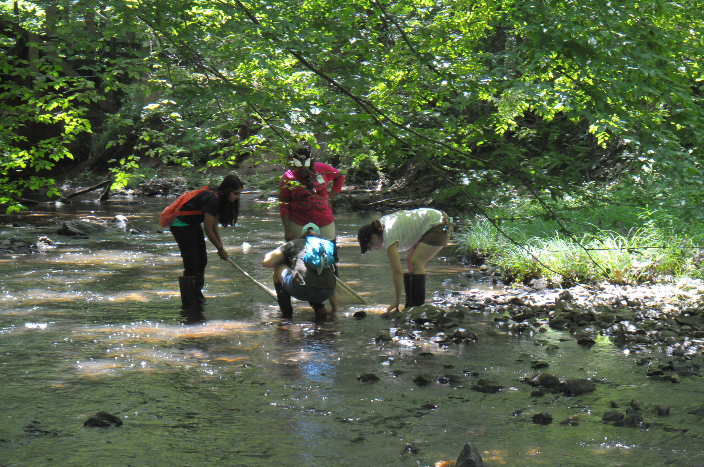
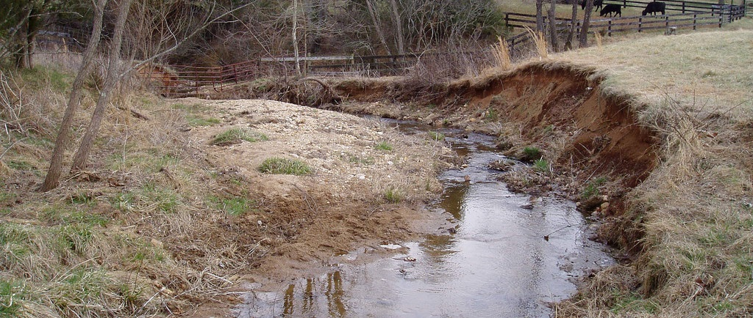
Healthy stream bank vegetation
Unhealthy stream bank vegetation
Notes:
The photo on the left shows a stream with excellent bank vegetation – these streams receive good shade and won’t have trouble with thermal pollution.
If the canopy were disturbed, the water would be heated by the sun.

Slide 14
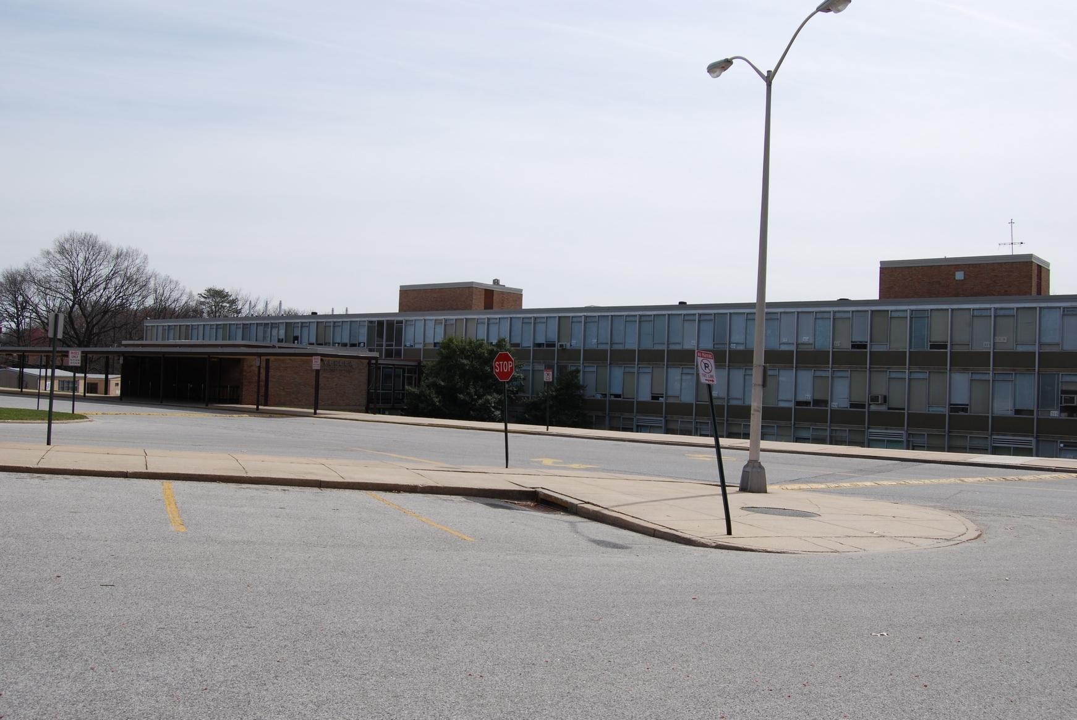
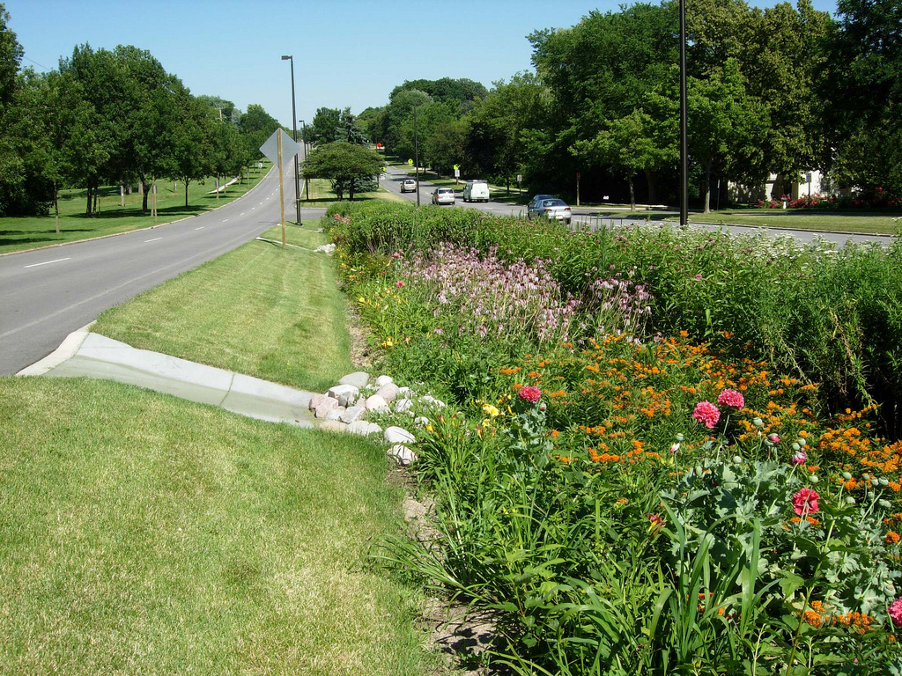
Heated water from pavement directly enters storm drain/streams.
One solution is installing green buffers to slow water down.
Notes:
The picture below shows a typical parking lot after a strong summer rainstorm. Impervious surfaces act as "fast lanes" for rainfall to make its way into streams. Rain that falls on a parking lot that has been baking in the sun all day during summer gets super heated and then runs off into streams. This heated water can be a shock to the aquatic life in the stream and can, thus, harm the water quality of the stream.
The picture above shows the parking surfaces are tilted so that they drain into a natural area that allows runoff to soak into the ground. Water-loving plants are also being grown in the area. A significant amount of the runoff should be captured by these areas, and by the time a portion of the runoff reaches a stream, the water temperatures should be closer to normal stream temperatures.

Slide 15
FECAL COLIFORM
Bacteria from feces of humans and other vertebrate animals
The presence of fecal contamination is an indicator of a potential health risk
Importance
Acceptable Levels
0 for drinking water; < 235 for swimming
Colonies/100 mL
Fecal Contamination
Units of Measure
Caused by:
Notes:
E. Coli is the most common fecal coliform.
The presence of E.coli in water indicates recent fecal contamination and may indicate the possible presence of disease-causing pathogens, such as bacteria, viruses, and parasites. Although most strains of E.coli bacteria are harmless, certain strains, such as E.coli 0157:H7, may cause illness.
Primary contact – (<200 desirable)(,1,000 acceptable) high area dermal contact (large surface area of skin), swimming
Secondary contact – (<1,000 desirable)(,5,000 acceptable) low area dermal contact(small surface area of skin), boating

Slide 16
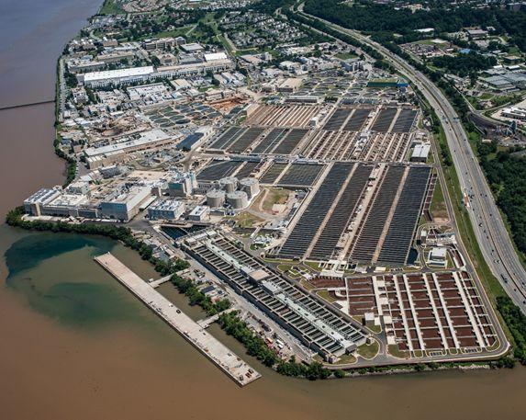
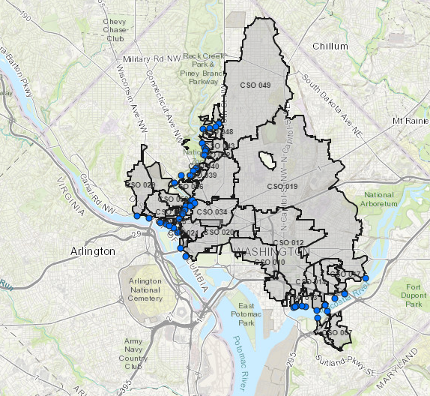
On an average day, the facility treats close to 300 million gallons of wastewater and has the ability to treat over 1 billion gallons a day at peak flow.
Blue Plains Wastewater Treatment Plant
3 billion gallons of raw sewage overflows into Rock Creek, Anacostia and the Potomac Rivers on an annual basis. When heavy rain occurs, the sewers are designed to let the excess flow, which is a mixture of stormwater and sanitary wastes. This excess flow is called combined sewer overflow or CSO.
Notes:
Rainwater often overloads the city's outdated combined sewer system, causing more than three billion gallons of raw sewage to overflow directly into the Anacostia River, Potomac River, and Rock Creek in an average year. There are 59 combined sewer outfalls in the District, the largest ones discharging into the Anacostia. These discharges cause violations of standards for bacteria, oxygen, suspended solids, and other pollutants.
Source: Earth Justice website (http://www.earthjustice.org/urgent/print.html?ID=17)
WSSC serves 1.6 million people in Montgomery and Prince George’s counties
According to WSSC’s own reports to Maryland’s Department of the Environment, from January 2001 through July of this year, WSSC’s sewer system experienced 445 overflows that dumped more than 91 million gallons of raw sewage into streams and rivers in Montgomery and Prince George’s counties. Discharges of raw sewage into waterways are illegal under the federal Clean Water Act.
… likely many more than 445 sewer overflows over the last three-and-a-half years. Those were just the discharges WSSC reported.
The Anacostia Watershed Society (AWS), one of the plaintiffs in the lawsuit, has been documenting WSSC sewer system problems for several years, and estimates that there are hundreds of miles of broken and separated pipeline that may be leaking sewage into the water table in Maryland.
Source: AWS press release

Slide 17
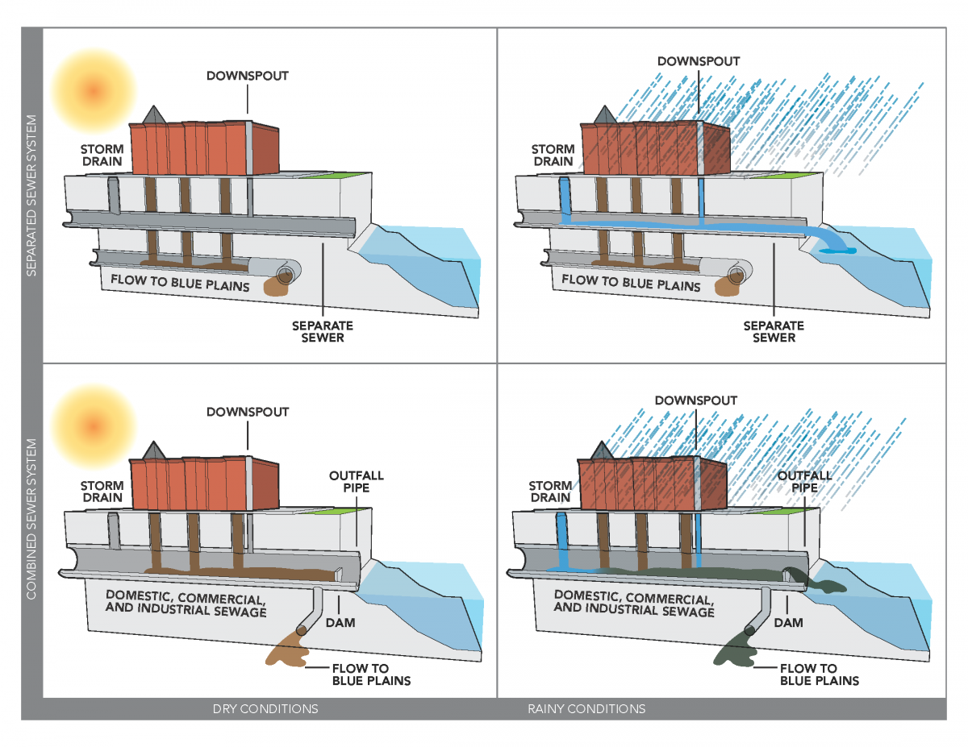
The Combined sewer overflow system has been in operation in DC since the 1930s. About 750 communities around the country still use this system.
Notes:
https://news.nationalgeographic.com/news/2014/07/140703-combined-sewer-overflow-washington-storm-water-tunnel/
https://www.dcwater.com/css

Slide 18
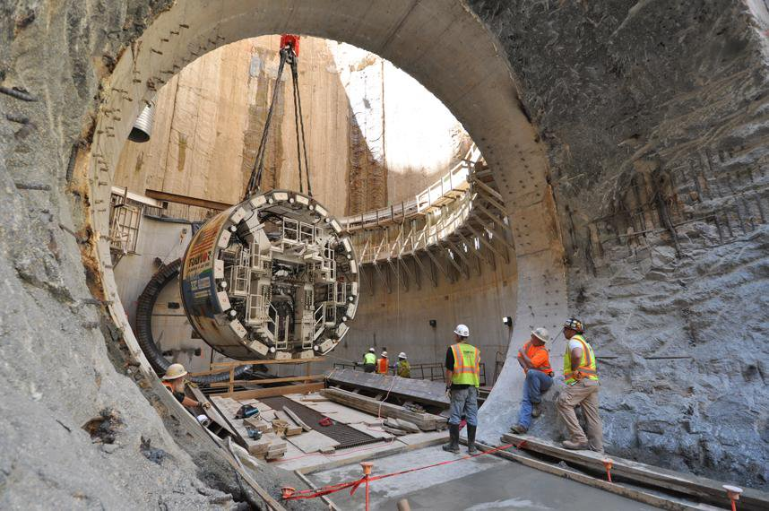
The new tunnel is a central piece of D.C.'s $2.6 billion Clean Rivers Project, a 20-year effort spanning 2005 to 2025. The goal is to get the Potomac and Anacostia rivers swimmable and fishable again. Storm water collected in drains off city streets will be channeled into the new 13-mile tunnel, which will run parallel to the rivers and empty into the soon-to-be expanded Blue Plains water treatment plant.

Slide 19
pH
Acidity or Alkalinity caused by hydrogen ion (H+) concentration in sample
pH outside of the acceptable range reduces the ability of organisms to survive, thereby reducing biodiversity.
Importance
Acceptable Levels
6.5-8.5
Ranges from 0 -14
7 considered neutral
below 7 are considered acids
above 7 are considered bases
Rainwater (acidic)
Runoff from agricultural and industrial areas
Units of Measure
Caused by:
Notes:
Low pH (acid) can make toxic substances more mobile and easier for aquatic plants and animals to absorb.
Aquatic plants help to buffer the pH by absorbing CO2, thereby raising the pH (CO2 makes water more acidic)
pH: the inverse log of the ratio of H+ ions to OH- ions
Data for site Beltsville rainwater pH 5.05 (2015)(National Atmospheric Deposition Program)

Slide 21
ORTHOPHOSPHATES
Phosphate (phosphorous and oxygen) (PO₄ ⁻³) ion, unbonded
Excess phosphates cause algae blooms which cause fluctuations in dissolved oxygen.
Importance
Acceptable Levels
<4 mg/L
mg/L
Lawn fertilizers
Detergents with phosphate water softeners
Human and animal waste
Units of Measure
Caused by:
Notes:
Orthophosphates are one phosphorous ion bonded with four oxygen ions and are readily available for uptake by plants.
Define EUTROPHICATION:
Eutrophication is the increase of nutrients in a body of water. This causes excess algae and plant growth, which increases turbidity and decreases photosynthesis of plants on the bottom of the water body. When those algae die, oxygen-consuming bacteria decompose the organic matter. Both of these processes decrease the amount of dissolved oxygen in the stream.

Slide 22
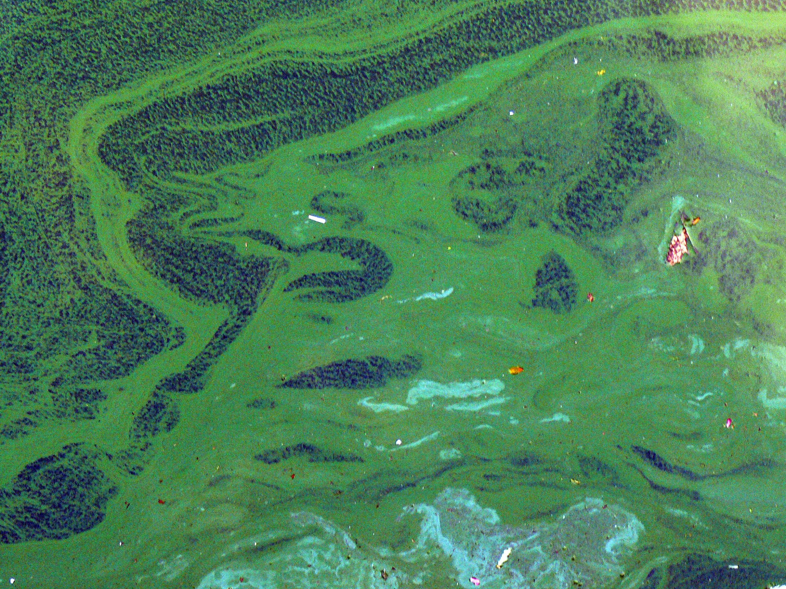
EXTRA NUTRIENTS 🡪 MORE ALGAE 🡪 MORE TURBIDITY 🡪 LESS PHOTOSYNTHESIS
🡪 MORE ALGAE + BACTERIA THAT DECOMPOSE ORGANIC MATTER
= LESS DISSOLVED OXYGEN!
Notes:
Excess phosphates leads to excess algae growth.

Slide 23
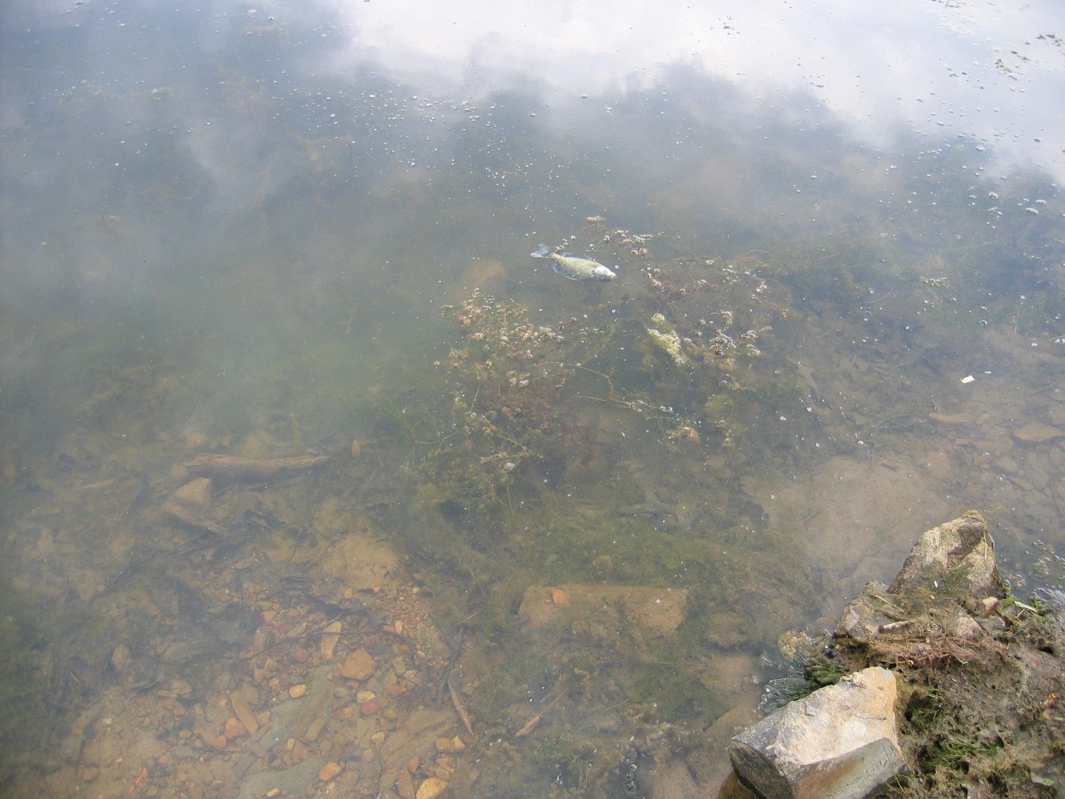
Notes:
This photo is of a eutrophied lake in Bryce, VA. Runoff of manure from a lakeside horse farm has put excess phosphates into the lake for years. Note the dead fish!

Slide 24
NITRATES
NITROGEN AND OXYGEN (NO₃ ⁻¹) ION
Though a certain amount of nitrogen is necessary in aquatic ecosystems, too much can cause excess algae growth which can cause fluctuations in dissolved oxygen.
Importance
Acceptable Levels
< 4.4 mg/L
mg/L
Fertilizers
Sewage
Manure
Units of Measure
Caused by:
Notes:
Nitrogen is abundant in the environment.
> 4.4 mg/L is unsafe for drinking water!

Slide 25
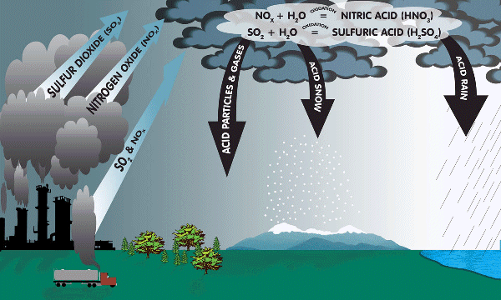
ACID RAIN
Notes:
NOx (nitrogen oxides) molecules are released in auto exhaust and combine with water droplets in the atmosphere.
These nitrates then fall to earth and travel through the watershed.
NOx – products of fossil fuel combustion:
NO = nitric oxide (most common)
NO2 = nitrogen dioxide
N2O = nitrous oxide

Slide 26
TURBIDITY
Relative clarity of water
Reduces light to aquatic plants resulting in lower dissolved oxygen levels.
Importance
Acceptable Levels
< 0.5 JTU for drinking water
<40 JTU for aquatic life
Jackson Turbidity Units (JTU)
Units of Measure
Caused by:
Soil erosion along a waterway caused by deforestation
Plankton, including algae and various microbes
Notes:
Suspended particles absorb heat energy from the sun, so water temperature increases with increased turbidity. Warmer water holds less dissolved oxygen, so DO decreases.
Turbid water does not allow as much light to pass through to SAVs for photosynthesis. Photosynthesis decreases and so does oxygen production. DO decreases.
Source: https://archive.epa.gov/water/archive/web/html/vms55.html

Slide 27
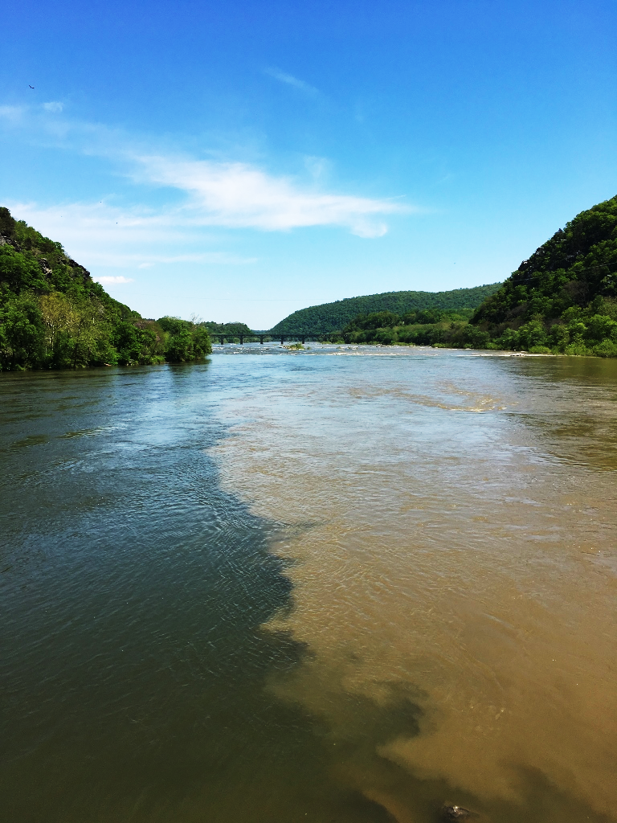
Notes:
Confluence of Shenandoah and Potomac Rivers at Harper’s Ferry

Slide 28
TOTAL DISSOLVED SOLIDS
Amount of material dissolved in the water
Affects the water balance in the cells of aquatic organisms
Importance
Acceptable Levels
100 – 2,000 ppm
ppm
Salt from streets
Fertilizer runoff
Wastewater treatment plants
Units of Measure
Caused by:
Notes:
The concentration of total dissolved solids affects the water balance in the cells of aquatic organisms. An organism placed in water with a very low level of solids, such as distilled water, will swell up because water will tend to move into its cells, which have a higher concentration of solids. An organism placed in water with a high concentration of solids will shrink somewhat because the water in its cells will tend to move out. This will in turn affect the organism's ability to maintain the proper cell density, making it difficult to keep its position in the water column. It might float up or sink down to a depth to which it is not adapted, and it might not survive.

Slide 29
WATER QUALITY INDEX
The commonly-used water quality index (WQI) was developed by the National Sanitation Foundation (NSF) in 1970 to provide a baseline for comparing the water quality.
91-100: Excellent water quality
71-90: Good water quality
51-70: Medium or average water quality
26-50: Fair water quality
0-25: Poor water quality
WQI is a unit-less number ranging from 1 to 100
NSF selected 142 scientists to consider 35 water quality tests
Nine parameters were chosen
The scientists were then asked to graph the level of water quality ranging from 0 (worst) to 100 (best) from the raw data for each of these parameters.
The curves drawn were averaged to obtain a weighting curve for each parameter.
Results of the nine parameters are compared to the curves and a numerical value, or "q-value," is obtained.

Slide 30
WEIGHTING FACTORS
After the q-value is obtained, it is multiplied by a "weighting factor," based on that test’s importance in water quality.
Each parameter result has a contribution to the overall stream score
Fecal coliform is (16%) of total
BOD is (11%) of total
In the absence of both, divide your raw “total” by 73 to get your adjusted “total”

Slide 31
WHAT CAN I DO
Read Labels
Buy personal hygiene products made with natural ingredients.
Properly dispose of pharmaceuticals and personal-care products with endocrine-disrupting compounds that, when flushed down the toilet, contaminate the river.
Control Lawn Care
Treat your lawn during dry weather because heavy rainfall creates runoff.
Green Streets
Help tackle storm water by planning grassy areas along roads where rainwater can soak in and contaminants dissipate before entering rivers.
Consider low maintenance/
common native landscaping.
Notes:
https://www.washingtonpost.com/local/the-potomac-river-in-good-health-and-bad/2012/05/01/gIQAQUuAxT_story.html?utm_term=.3506cb3cc991

Slide 32
REFERENCES:
BTW WATERSHED WATCHDOGS RESOURCE BOOKLET
MDE WEBSITE: HTTP://WWW.MDE.STATE.MD.US/PROGRAMS/MULTIMEDIAPROGRAMS/ENVIRON_EMERGENCIES/FISHKILLS_MD/INDEX.ASP
EARTH JUSTICE WEBSITE:
HTTP://WWW.EARTHJUSTICE.ORG/URGENT/PRINT.HTML?ID=17
NY STATE DEPT OF ENVIRONMENTAL CONSERVATION: HTTP://WWW.DEC.STATE.NY.US/WEBSITE/DAR/OOD/ACIDRAIN.HTML
AUSTRALIAN GOVERNMENT (OZESTUARIES): HTTP://WWW.OZESTUARIES.ORG/ORACLE/OZESTUARIES/INDICATORS/IN_TURBIDITY_F.HTML
BIOLOGY CORNER: HTTP://WWW.BIOLOGYCORNER.COM/BIO1/DIFFUSION.HTML

